Slide 1
NATIONAL URBAN ALLIANCE
WORKSHOP FOR TEACHERS
LOUISE LINDSAY, MENTOR NATIONAL URBAN ALLIANCE

Slide 2
Welcome Back!!
Self-Affirmations
Reflect on something you are proud of from school this year. Be ready to share.

Slide 3
TRIVIA
Create your Trivia team name.
Make a reference to NUA in the name.

Slide 4
EMBRACE
REPETITION

Slide 5
NUA Goals
Expectation of high intellectual performance for all students.
Student learning and growth that demonstrates HIP on a variety of measures.
Professional development that motivates teaching toward HIP.
NUA Beliefs
Intelligence is modifiable
All students benefit from a focus on high intellectual performance.
Learning is influenced by the interaction of Culture, Language, and Cognition

Slide 6
TRIVIA

Slide 7
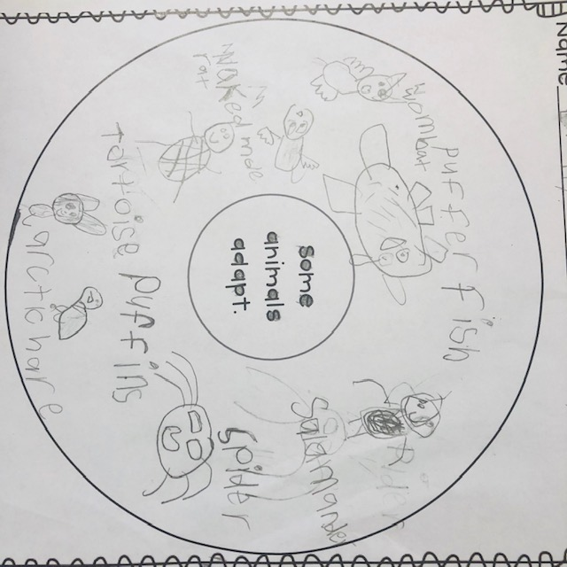
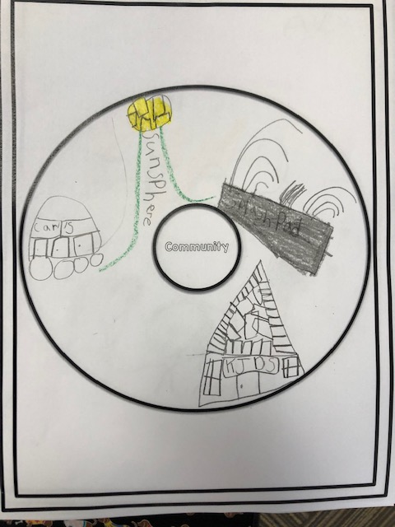
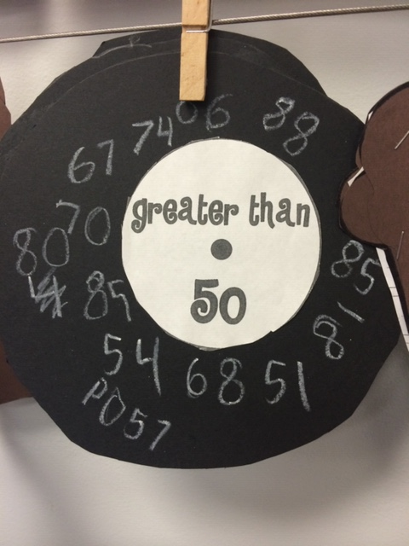
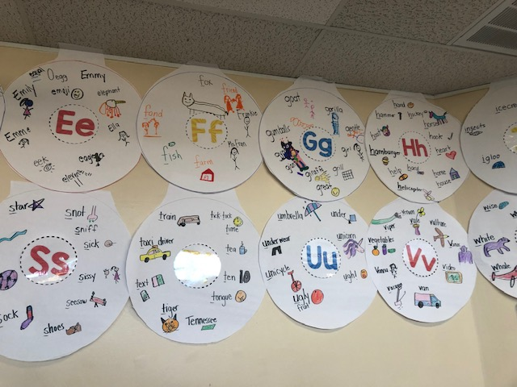
Name the map and the cognitive process
Circle Map: Defining in Context

Slide 8
Circles of My Multicultural Self
First, create a Circle Map with 4 quadrants, each of which naming a dimension of self that you feel is defining for you. Examples may include but are not limited to: job, family role, region of origin, country of origin, hobby, interest, religion, gender, etc…
Mother
4
Louise
Southerner
Deep Thinker

Slide 9
Circles of My Multicultural Self
Next, find a partner who you don’t know super well.. Then, tell your partner 2 brief stories, one about a time that you were especially proud to be associated with one of your words, and one when you associated one of the
words with
something
painful.
Mother
4
Louise
Southerner
Deep Thinker

Slide 10
Circles of My Multicultural Self
Finally, share a stereotype you have heard about one dimension of your identity that fails to describe you accurately. Complete the following sentence : “I am (a/an) _________ but I am NOT (a/an) ______.”
I am southern, but I am not stupid.
I am a deep thinker, but I am not self-righteous (or I try not to be).
I am a 4, but I am not melancholy.
These will be read aloud.

Slide 11
NUA Notebook
Date | Topic/Strategy/Activity | Page
 | Circles of My Multicultural Self

Slide 12
Something Beautiful
Think of a place near or far. Visualize the place. Notice the details in your mind.
As the music starts, move through the room. When it stops, share your beautiful place with a partner.

Slide 13
The Explanation Game
With your partner, walk around the room, looking at the photos
on the wall. As you do, play the Explanation Game for the photos,
as a whole.
Name It: name a feature or aspect that you see.
Explain It: What could you be looking at?
Give Reasons: What makes you say that?
Generate Alternatives: What else could it be?
What makes you say that?
Share your explanations.
Share your experience of The Explanation Game.

Slide 14
NUA Notebook
Date | Topic/Strategy/Activity | Page
 | The Explanation Game

Slide 15
TRIVIA

Slide 16
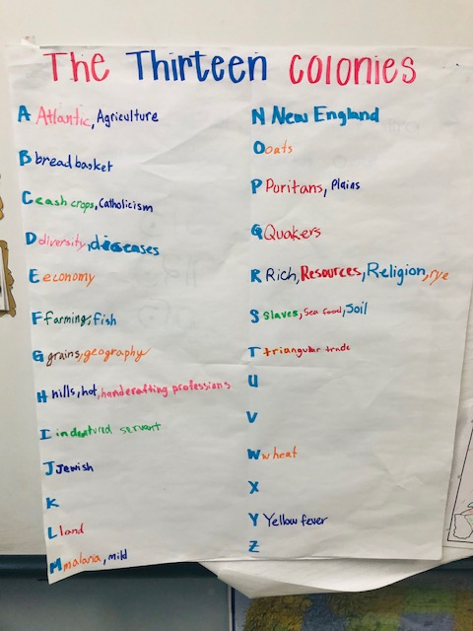
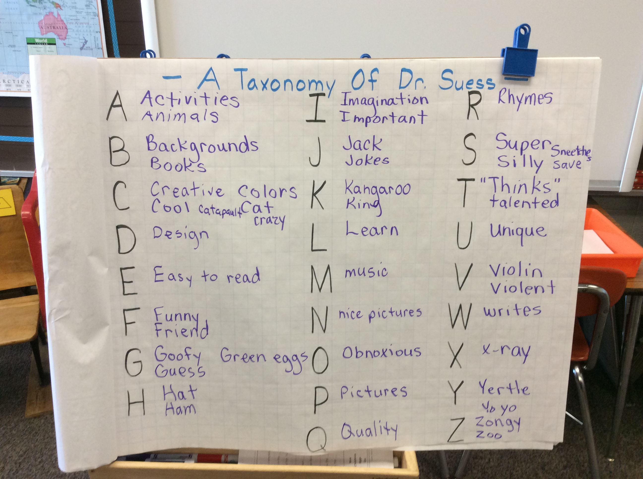
Name the strategy and explain why it is effective.

Slide 17
Anticipation/Reaction Guide about Appalachia
1.Appalachia is a chain of mountain ranges that runs through the states of Georgia, Tennessee, Kentucky, Virginia, West Virginia, North Carolina, and Maryland. 2. Everyone in Appalachia has outhouses and goes bare-foot.
3. The first Appalachians were European settlers from England, Scotland, Ireland, and Germany. 4. Mountain music, storytelling, folk arts and crafts, basket making, and woodworking are important to the Appalachian culture.
5. Farming was important to Appalachians, and very few farmers left their farms even though they would make more money in the coal fields. 6. African Americans make up over half of the Appalachian population today.
7. Presidents John F. Kennedy and Lyndon B. Johnson determined that poverty was a huge problem in the Appalachians and started programs to try and help people in the region. 8. Today, many people have left the Appalachians and the traditional way of life in order to find employment.

Slide 18
Color. Symbol. Image
Read the article from a native of Appalachia
Then create 3 things to represent what you read.
A Color
A symbol
An image

Slide 19
NUA Notebook
Date | Topic/Strategy/Activity | Page
 | Color. Symbol. Image.

Slide 20
Defining Format
Question | Category | Characteristics
What is WISDOM? Wisdom is ___ | a/an | 1. 2. 3. 4. 5. 6.

Slide 21
TRIVIA

Slide 22
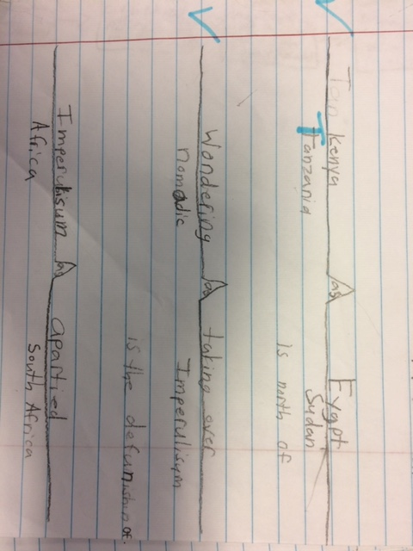
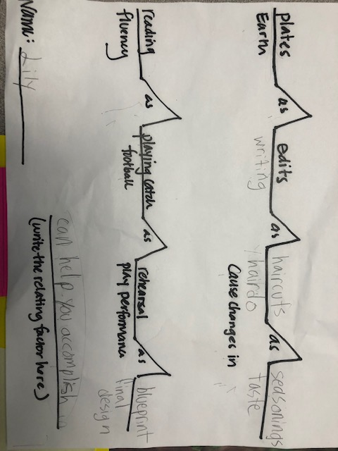
Name the map and the cognitive function

Slide 23
Punctuate Your Thoughts
Reading in The Pedagogy of Confidence: from “The Reciprocal Neurocognitive Interaction” on p.82 – the end of page 85.
As you read, Punctuate Your Thoughts.
+ = something you agree with
- = something you disagree with
? = something you wonder
! = something you are excited about.

Slide 24
Identifying and Activating Student Strengths
Amplifying Student Voice
Building Relationships
High Operational Practices
Eliciting High Intellectual Performance
Situating Learning in the Lives of Students
Integrating Prerequisites for Academic Learning
Providing Enrichment

Slide 25
TRIVIA

Slide 26
Name the map and the cognitive function

Slide 27
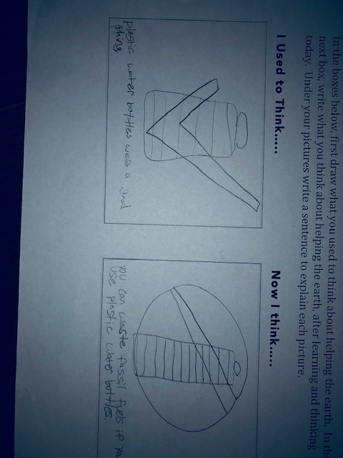
I Used to Think… Now I Think

Slide 28
TRIVIA

Slide 29
Create a Bubble Map with
OUR STUDENTS in the center.

Slide 30
Take a Risk Choose a strategy that intimidates you. On chart paper, practice that strategy using skills or content from your class. Put your chart up on the wall. | Compile Add to the NUA Strategy Review chart on the wall. Add sticky note questions to strategies already there, if needed. | Plan for a lesson… Choose a topic for next week, then select an NUA strategy that you will use with the topic. Tell one person why you chose that strategy for the topic.
Ask a Question Look back into your NUA notebook. Find a place where you need clarity. Ask someone for help. | FREE SPACE Take a break | Share the Love Look at the posters of strategies, choose one to affirm with a specific affirmation on a sticky note.
Review Create 12 TRIVIA questions that you can use to help you students look back on learning this year. | Check Your Resources Look through the NUA/EC/OV shared drive. Put a sticky note on the wall for this section. It can be a question, suggestion, or shout out. | Exit Ticket Complete the exit ticket for today. The more info you provide, them ore NUA can grow in support of teachers.
Task TIC TAC TOE!

Slide 31
Discussion….
Is NUA good for your school?
How do we increase NUA strategy use in your school?
What can your admin team do to help?
What can the equity team do to help?
What can you do?

Slide 32
Stories of Place
Beauty. Peace. Family. Simplicity.

