Slide 1


Student Engagement and Equity Consciousness
Palmer Lake Elementary
26 February 2021
Robert Seth Price
www.eggplant.org • robert@eggplant.org
National Urban Alliance
www.nuatc.org
Notes:
Linda welcomes Board

Slide 2
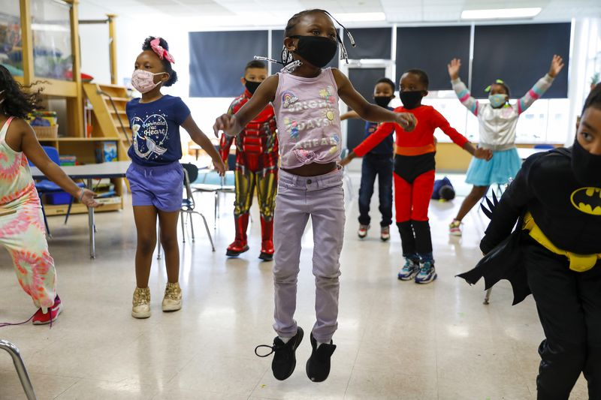

Slide 3
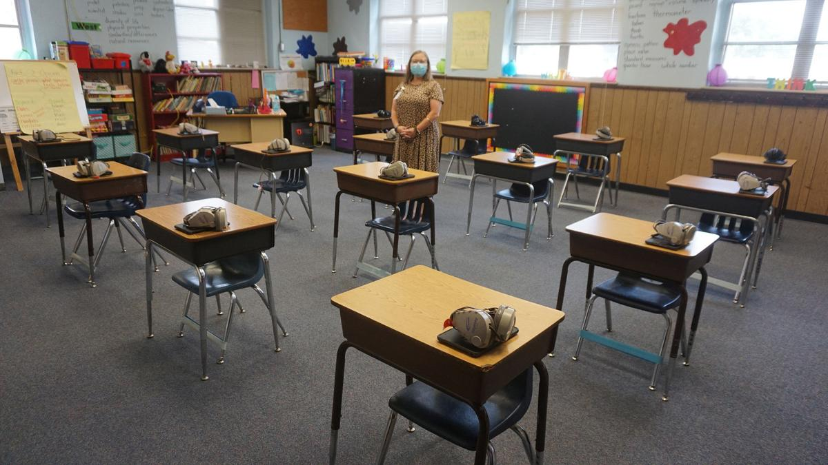
Community

Slide 4
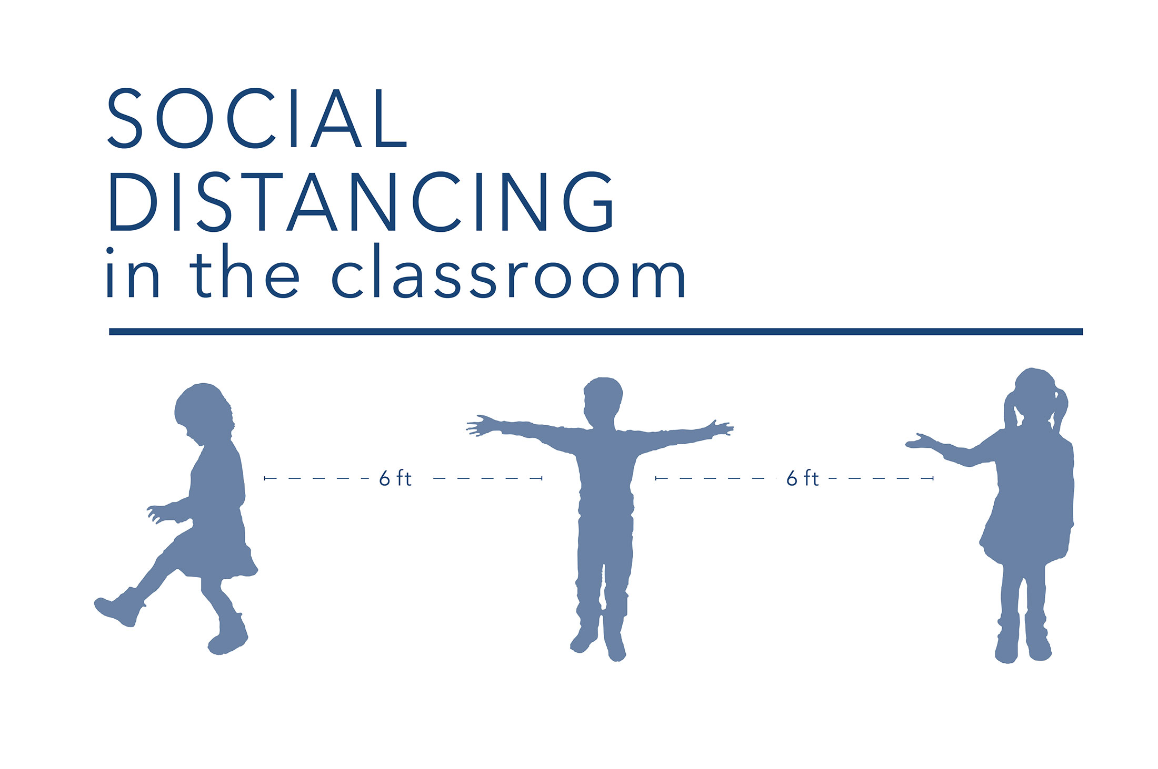
Community

Slide 5
Multi-Flow Map: Cause and Effect
input
event
Effects / Outcomes
Provides a space to build trust
Building
Community
& Social Distancing
Promotes a growth mindset

Slide 6
Multi-Flow Map: Cause and Effect
input
event
Effects / Outcomes
Provides a space to build trust
Building
Community
& Social Distancing
Promotes a growth mindset

Slide 7
Multi-Flow Map: Cause and Effect
input
event
Effects / Outcomes
Practice
Provides a space to build trust
Building
Community
& Social Distancing
Routine
Models of
Excellence
Promotes a growth mindset

Slide 8
Multi-Flow Map: Cause and Effect + Frame of Reference
input
event
Effects / Outcomes
Provides a space to build trust
Building
Community
& Social Distancing
Promotes a growth mindset
Who • How • Regularity • Practice • Models of Excellence • Roles

Slide 9
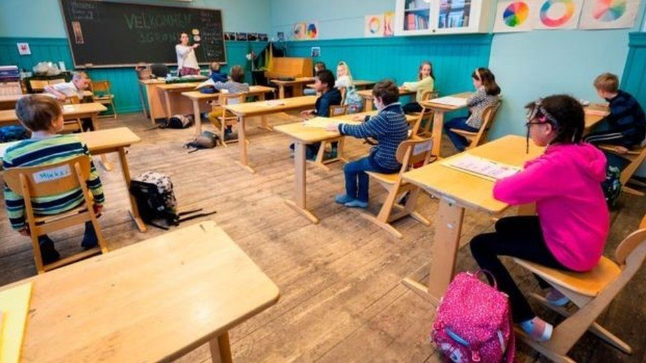
Engagement

Slide 10
Pro Active

Slide 11
Today: Feb 26, 2021
Community
Community with Social Distancing
Thinking
Environments
Collaboration
Student Engagement
Relationships
Belief and Belonging
Equity Consciousness
Belief
People
Materials
Objects
Whole Community
Observing
Pedagogical Flow Map

Slide 12


HOPs
^{High Operational Practices}
of the Pedagogy of Confidence support and enhance equity:
Identifying and activating student strengths
Eliciting high intellectual performance
Integrating prerequisites for academic learning
Situating learning in the lives of students
^{Building relationships}
^{Providing enrichment}
^{Amplifying student voice}
Belief and Belonging
Notes:
Understanding from research and data, doing with practical models and strategies by practicing for expertise and mastery

Slide 13
CLEAR
Cultural
emphasizes purpose of
what is
being learned
in relationship
to one’s
own culture
Learning
choices in
content &
assessment
based on own experiences
values, needs
and strengths
Equitable
with learning
environments
where students
racial & ethnic
diversity is
valued which
contributes to
successful
outcomes
Achievement
in multiple ways
to represent knowledge and skills allowing for attainment of outcomes at
different points of time
Responsive
to positive relationships, rigorous learning experiences and higher order thinking to address the world in a relevant action oriented manner

Slide 14
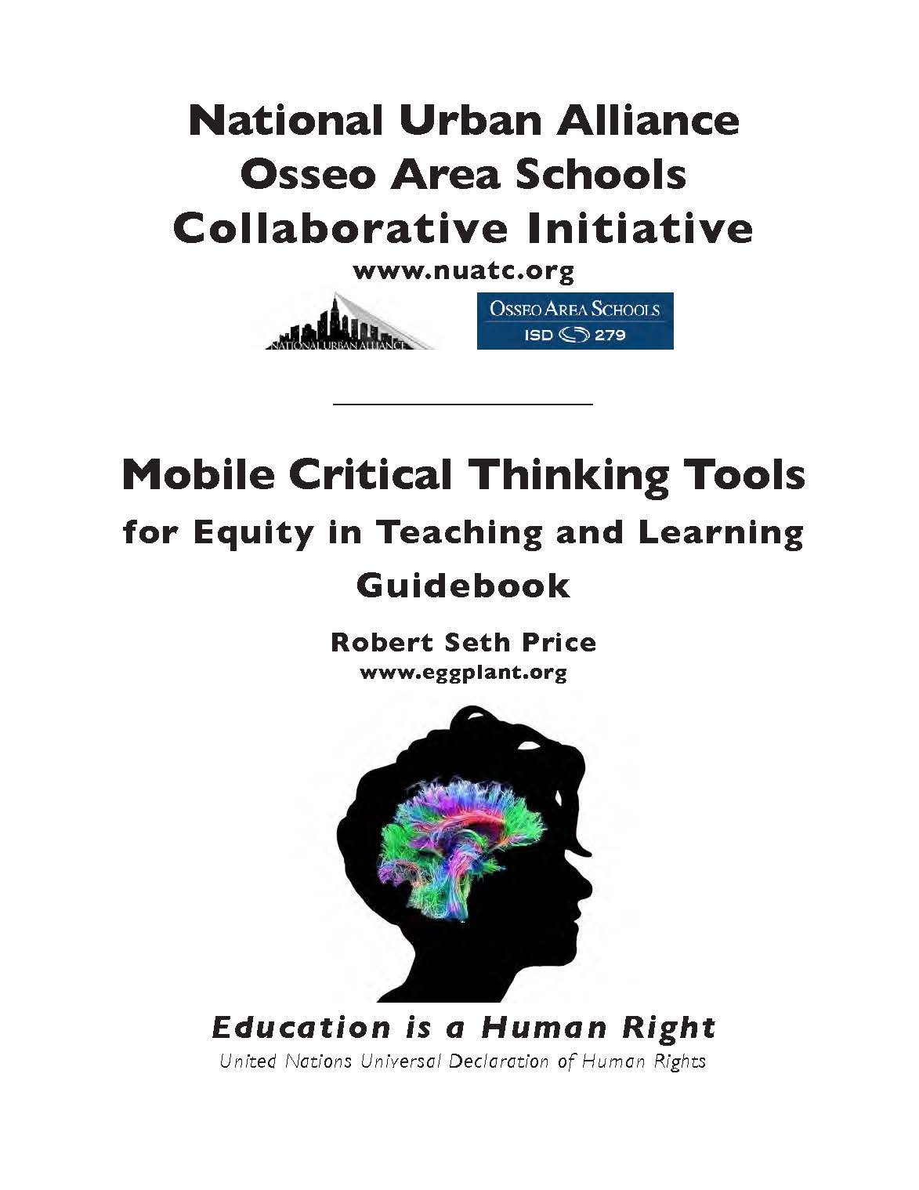
High Operational Practices of the Pedagogy of Confidence support and enhance equity:
Notes:
The tools———of HOPs for critical thinking EQUITY

Slide 15
Thinking Environment
Belief
People
Materials
Objects
Thinking Environment
Belief
People
Materials
Objects

Slide 16
Belief

Slide 17
Visualizing Belief and Belonging.
Situating Learning in the Lives of Students
Amplifying Student Voice

Slide 18
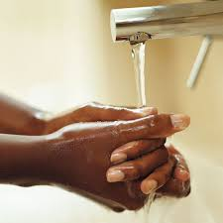
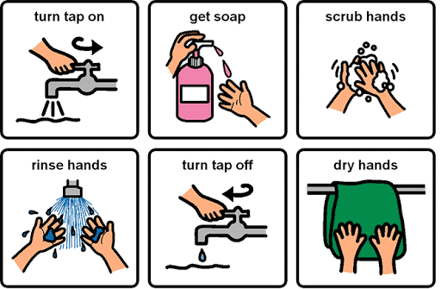
Models of Excellence
Create Models from and for the Class – Children Create Their Own

Slide 19
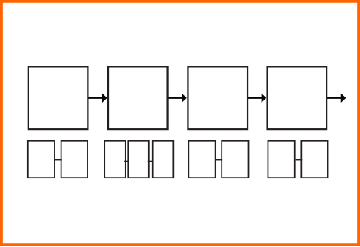
Sequence
Sharing
Modeling
Doing
Affirmations
Sequence
Sharing
Modeling
Doing
Affirmations
Students Create
Flow Maps of
How To Do

Slide 20
Word Wall of Excellence
Healthy Hands
Space Together
Hello Gestures
Sanitizer
Practice
Listening
Observing
Caring
Respecting

Slide 21
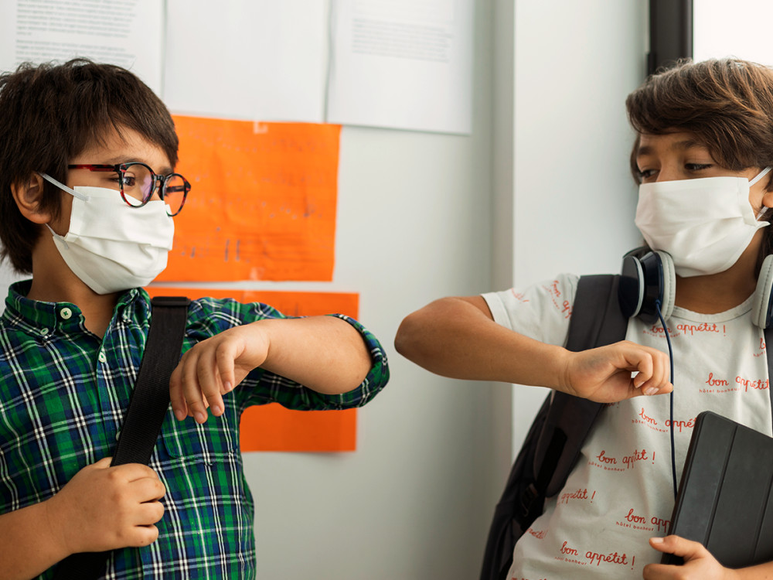
People
People

Slide 22
People
Space
Collaboration
Communicating
Observing and Listening

Slide 23
Community Building Exercises
Community Building Exercises
Mirroring – whole class, small groups, pairs
Pass the Ball
Hello
Students Creating Variations

Slide 24

Teacher Location
Movement by Teacher

Slide 25
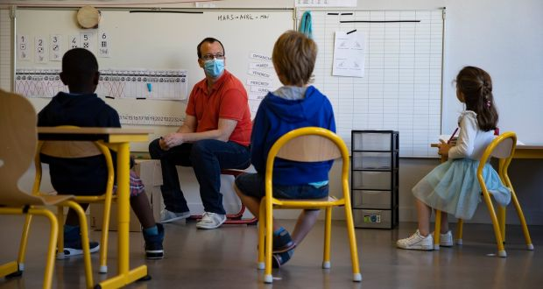
Small Groups
Model as a Fishbowl
—with teacher
—think aloud
—students modeling
—all small groups
Progressively
Implementing

Slide 26
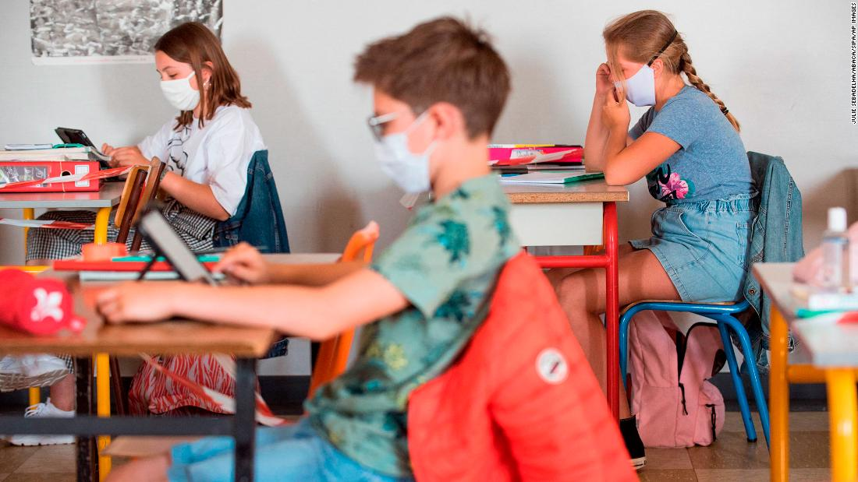
Chat Feature

Slide 27
Materials
Materials

Slide 28

?
Powerful Questions
Object • Concept • Image • Video • Song • Lyrics

Slide 30
?
Observations
Object • Concept • Image • Video • Song • Lyrics

Slide 31

Students Create
Flow Maps of
How To Do

Slide 32


Slide 33
What Do We Model as the School Adult Community Leaders?

Slide 34
Joy
Belief
Patience

Slide 35
Objects
Objects

Slide 36
Objects - Space

Slide 37
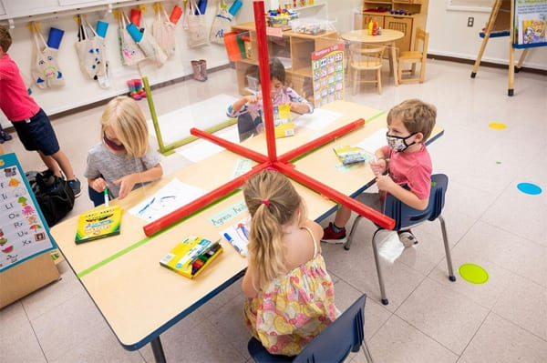
Objects - Space

Slide 38
Thinking Environment
Belief
People
Materials
Objects
Thinking Environment
Belief
People
Materials
Objects

Slide 39
Multi-Flow Map: Cause and Effect + Frame of Reference
input
event
Effects / Outcomes
Provides a space to build trust
Building
Community
& Social Distancing
Promotes a growth mindset
Who • How • Regularity • Practice • Models of Excellence • Roles

Slide 40

Strategy Review Chart
Name & Primitive | Cognitive Process/ Function | Remember | Best Use (Priming, Processing, Retaining for Mastery) | Source | Connection to HOPs, CLEAR

Slide 41
Thinking Maps as a Language
Describing in Context
Brainstorming
Comparing
& Contrasting
Categorizing
Describing
Sequencing
Cause and Effect
Whole / Part
Analogies
Relationships
To Organize Thinking – Student Centered
Notes:
Back to thinking with Thinking Maps — organizing thinking. Circle map for brainstorming — then organize…

Slide 42
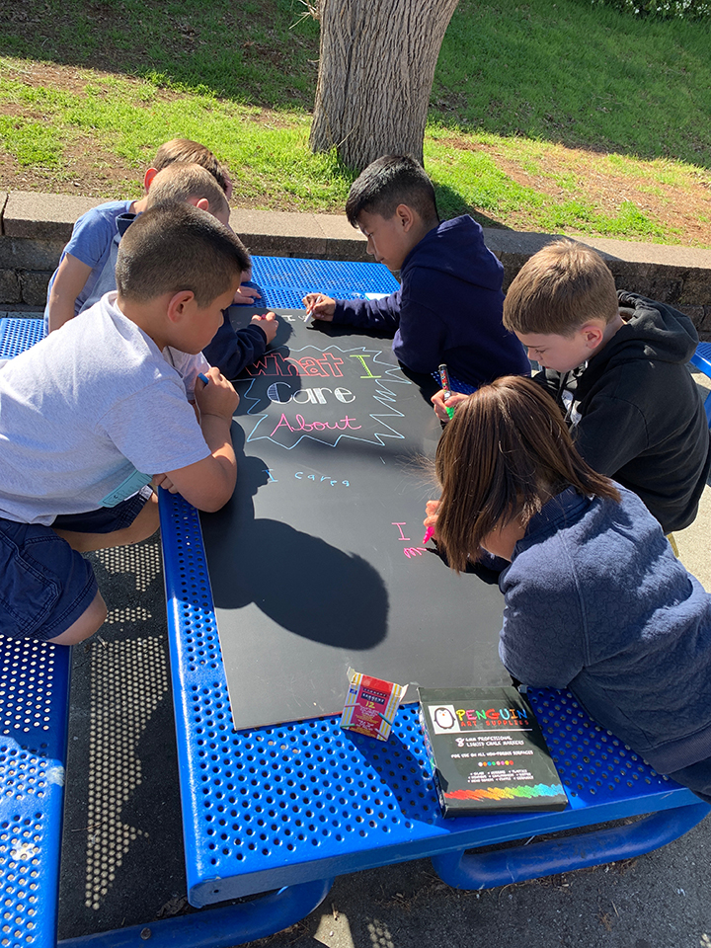
Community Building
Take a poll
How
High Operational Practices of the Pedagogy of Confidence support and enhance equity:
Notes:
The tools———of HOPs for critical thinking EQUITY

Slide 43
Thinking Maps Who Am I Guide
http://www.eggplant.org/pdf/WhoAmIStudentGuide-ThinkingMaps.pdf
NUA – OAS Critical Thinking Tools Guide
http://www.eggplant.org/pdf/Critical_Thinking_Guide_RSP_NUA_Osseo.pdf
Robert Seth Price
http://www.eggplant.org
PowerPoint of this meeting
http://www.eggplant.org/pp/RSP-NUA-Osseo_PLE_26Feb2021.pptx

Slide 44
3 Phases of Learning
Retaining for
Understanding
Priming
Processing
Getting
Ready
to Learn
Unpacking
Meaning
Holding on
to Learning
Structure
Notes:
2 maps in use — sequencing and categorical
even a cause and effect

Slide 45

Thank You
Robert Seth Price
www.eggplant.org • robert@eggplant.org
National Urban Alliance
www.nuatc.org

Slide 46
Student Engagement and Equity Consciousness
Fair Oaks Elementary
20 January 2021
Robert Seth Price
www.eggplant.org • robert@eggplant.org
National Urban Alliance
www.nuatc.org
Notes:
Linda welcomes Board

