Slide 1
Signs of Our Times (3 hours; 3 Focus Areas)
NUA/CLEAR Instructional Mediators Forum March 13, 2021
Session Collaborators
Maureen Araya-Osseo Area Schools
Stefanie Rome-NUA
Ann Schwartz-NUA
Hannah Storm-Osseo Area Schools

Slide 2
Saturday: In 3 Parts
Signs of the Times: Remembering Our Why
Focus on Relationships: NUA Foundations (toward a shared knowledge base)
Cognitive & Neuroscience
Equity Consciousness
Signs of the Times: Lifting All Voices
Focus on Processing World Events
Strategies for “Days After”
Signs of the Times: Listening to our Students
On Learning Loss
NUA Foundational Principles

Slide 3
Today’s Flow
dialogue
Introductions
&
Overview
Our Why
The I
The We
The Will
Lifting
All
Voices
Listening to
Our
Students
Next Steps
Final
Reflection
&
Feedback
discussion
discourse

Slide 4
Who’s in the Room?
Please type your first and last name, role/title and school in the chat.

Slide 5
Type # and then add a word, phrase or statement that expresses what you are thinking, feeling, connecting to in that moment.
# Stamping the Chat
Throughout the session, we will use the Chat window to process and make connections as a community.
As you feel led…
Example: #Strategize the Chat
Flashback
Notes:
Pairing: Put numbers on the back of the CLEAR handout and have the teachers find their partners in the room for the Cultural Pizza activity.

Slide 6
The Power of the Collective
As you feel led…
“Check the Chat” – Periodically check the chat. If you find a comment interesting or have a question, share it with the group and make space for a brief discussion.
“Quotable Quotes” – Read session quotes aloud as they appear on the screen and share why/how it resonates with you, making space for a brief discussion.
Flashback

Slide 7
@ the Foundation
foundational principles of NUA

Slide 8
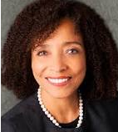
The Pedagogy of Confidence
NUA Senior Research Specialist
What?
Teacher
“The fearless expectation and support for all students to demonstrate high intellectual performance.”
Teacher Trainer
Professor
Scholar
Gifted Education Director
Why?
Self direction and self actualization

Slide 9
On Building Relationships
“There can be no significant learning without significant relationship.”
-Dr. James Comer

Slide 10
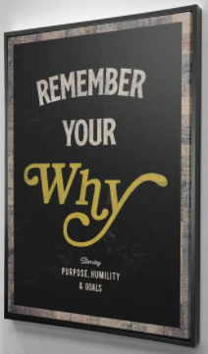
Part One: Remembering Our Why

Slide 11
The Collective Why- The Steps Involved
Community Builder
3-minute Quick Write
Consider your why and what brought you into the profession.
Complete the three stanzas of the poem on the next slide with information that speaks to your why.
“The I”

Slide 12
I Am Poem
I am ___________________________________________________________________.
I wonder _______________________________________________________________.
I hear __________________________________________________________________.
I see ___________________________________________________________________.
I want __________________________________________________________________.
I am ___________________________________________________________________.
I pretend ______________________________________________________________.
I feel __________________________________________________________________.
I touch ________________________________________________________________.
I worry ________________________________________________________________.
I cry ___________________________________________________________________.
I am __________________________________________________________________.
I understand ___________________________________________________________.
I say __________________________________________________________________.
I dream _______________________________________________________________.
I try __________________________________________________________________.
I hope ________________________________________________________________.
I am __________________________________________________________________.

Slide 13
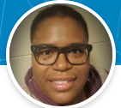
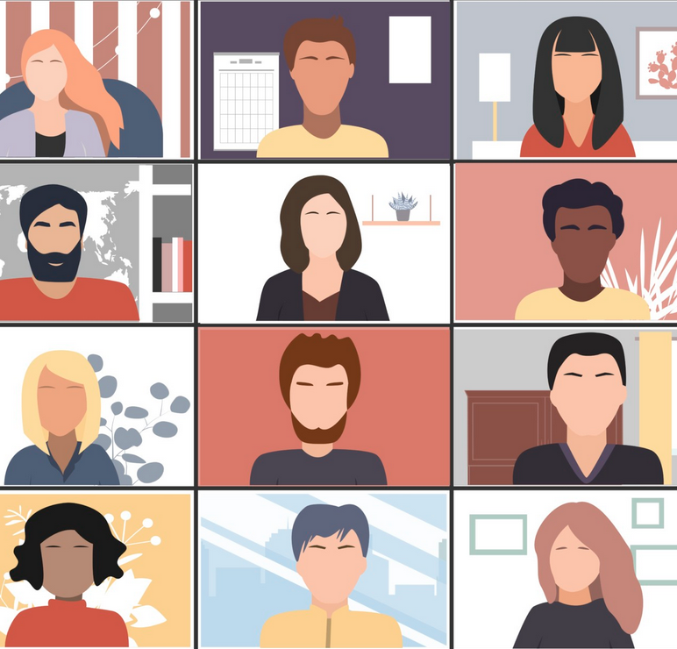
The “Speaker-Seeker” Challenge –Sharla Foster
We will join breakout rooms three times.
Each time you enter a new room, seek a speaker who will lead the sharing.
Join your breakout group.
Greet everyone and introduce yourselves.
Ask, “Who will be our Speaker Seeker?”
This person is the leader, shares first and keeps the sharing flowing.

Slide 14
Community Builder - The Collective Why
After introductions and seeking your speaker,
Share your first stanzas, only. (7 minutes)
If you have extra time, ask questions, discuss connections and points of interest.
When you get the signal to return to the main room, say goodbye to your group.
Join your next group.
Share your second stanzas, only. (7 minutes)
If you have extra time, ask questions, discuss connections and points of interest.
When you get the signal to return to the main room, say goodbye to your group.
Repeat the sequence for the third stanza. only. (7 minutes)

Slide 15
Community Conversation
Collective Connections

Slide 16
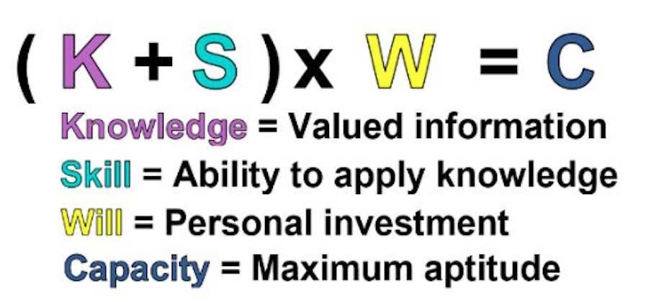
The Capacity Equation
Let’s deconstruct “The I” experience using the context of the System Equity Tools.
(5 minutes)

Slide 18
Introductions
#
Stamp the Chat
word, phrase or statement that expresses what you are thinking, feeling, or connecting to

Slide 19
Grab That
The Collective Why
I Am Poem
3 Stanzas – 3 Groups

Slide 20
Quotable Quotes
Dr. Evelyn Rothstein
Students respond to specific quotations from literary characters or people of note or accomplishment.
Students read and ponder the words of others and respond with their own words and ideas.
Responding to the words of others is a metacognitive activity that requires thought, reflection and empathy.
“The We”

Slide 21
2000
“You must fight the battle for dignity on the first day…”
“Sit down…and exchange views…”
“You have limited time to stay… use that period to transform…”
“The We”

Slide 22
“The Power of the Collective”
Mandela Video Here

Slide 23
Imitation Writing
Dr. Denise Nessel
Steps Involved:
Teacher selects (or writes) one or more model sentences.
Students read the model and copy it onto their papers.
Students first substitute synonyms for the key words (substitution).
Students then write original sentences, on different topics, adhering to the same syntax as the original (imitation).

Slide 24
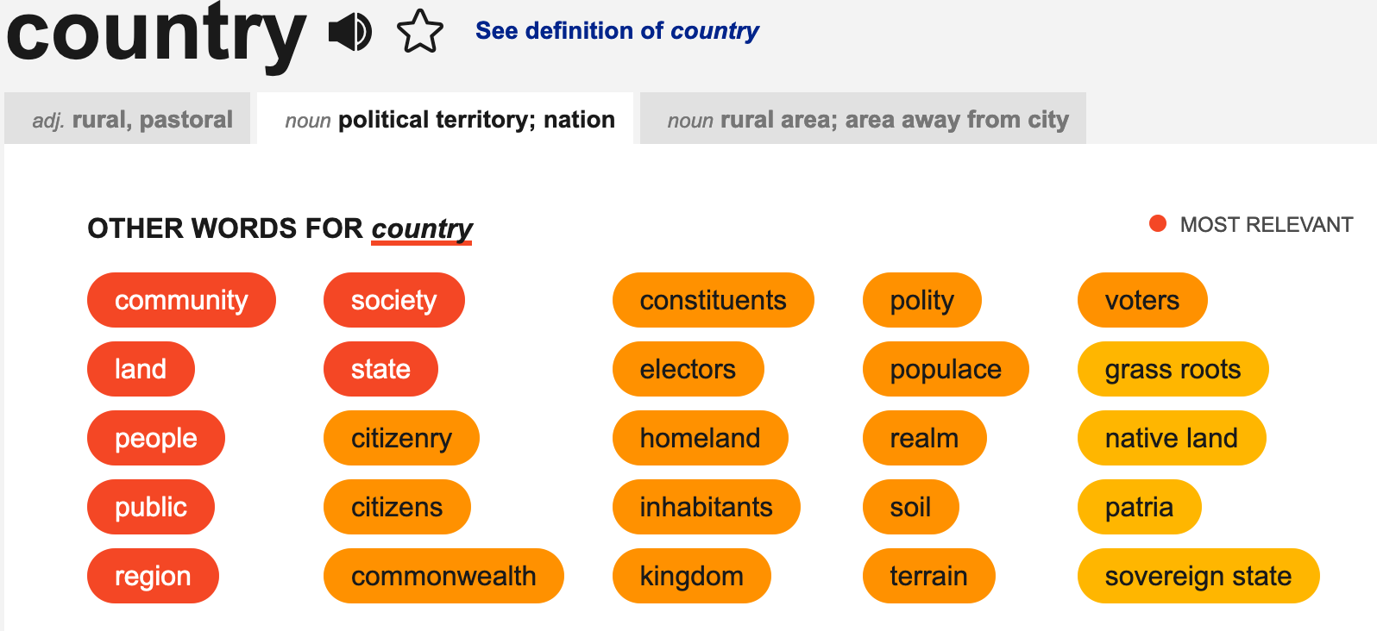
Quotable Quotes-Imitation Writing Mash Up

Slide 25
“You have limited time on Earth. You must try and use that period for the purpose of transforming your country into what you desire it to be…democratic, non-racist, non-sexist.” -Nelson Mandela
Work independently.
Visit your favorite source for synonyms.
Select and write 3-4 synonyms for each underlined word.
Decide on one replacement for each of the underlined words in Mandela’s quote.
Generate a similar statement the speaks to your why.
Example: “country”
community
neighborhood
district
school

Slide 26
The “Speaker-Seeker” Challenge –Sharla Foster
Join your breakout room.
Greet everyone and introduce yourselves.
The Speaker Seeker is the person who is sitting closest to a flowing water source (sink, shower, hose,…).
This person is the leader, shares first and keeps the sharing flowing.
Share your Mash Ups with your group.
Affirm each other, ask questions, make connections.
When you get the signal to return to the main room, say goodbye to your group.

Slide 27
Community Conversation
Collective Connections

Slide 28
The Capacity Equation
Let’s deconstruct The We experience in the context using System Equity Tools. (5 minutes)

Slide 30
Introductions
#
Stamp the Chat
word, phrase or statement that expresses what you are thinking, feeling, or connecting to

Slide 31
Grab That
Quotable Quotes
Imitation Writing
The Mash Up

Slide 32
Community Builder
“Fierce Urgency”
“The Will”

Slide 33
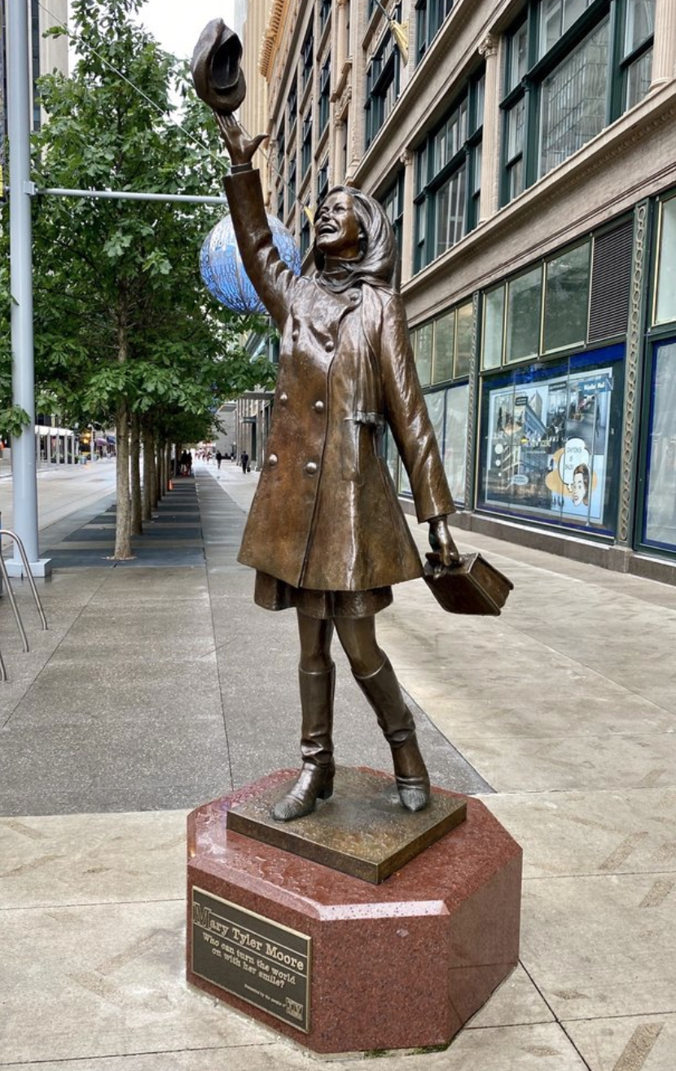
“Fierce Urgency”-
The Steps Involved
Consider our work as educators.
Identify one specific goal that you will start working toward immediately with the “fierce urgency of now”.
Use the frame on the next slide to write about your “fierce urgency”.

Slide 34
“Fierce Urgency”-
The Frame
I will immediately start working toward _________________ with the fierce urgency of now.
I will work toward ________________________ because _____________________________________________________.

Slide 35
The “Speaker-Seeker” Challenge –Sharla Foster
Join your breakout room.
Greet everyone and introduce yourselves.
The Speaker Seeker is the person born closest to the Mary Tyler Moore statue on Nicollet Mall.
This person is the leader, shares first and keeps the sharing flowing.
Continue sharing your Fierce Urgency statements until all have shared.
Affirm each other, ask questions, make connections.
When you get the signal to return to the main room, say goodbye to your group.

Slide 36
Community Conversation
Collective Connections

Slide 37
The Capacity Equation
Let’s deconstruct the I Am experience using the System Equity Tools. (5 minutes)

Slide 39
Introductions
#
Stamp the Chat
word, phrase or statement that expresses what you are thinking, feeling, or connecting to

Slide 40
Grab That
The Fierce Urgency

Slide 41
@ the Foundation
foundational principles of the POC
Osseo Area System Equity Tools
Mash Up

Slide 42
Osseo Area System Equity Tools
POC 7 HIGH OPERATIONAL PRACTICES
Identifying and Activating Strengths
Building Relationships
Nurturing High Intellectual Performances
Providing Enrichment
Incorporating Prerequisites
Situating Learning In The Lives Of Student
Amplifying Student Voice
What connections do you see?
Notes:
cultural focus on weakness results in the strengths of these students sanctioned to be ignored, undervalued, or the most daunting, believed to be nonexistent. FEAR with certainty there are no possibilities
Race – socially constructed - Native American – suppose to originate in Asia
G/T -
Result –catalyze and perpetuate underperformance
Fixed mindset

Slide 43
Grab That
The Speaker Seeker

Slide 44
Part Two: Lifting All Voices

Slide 45
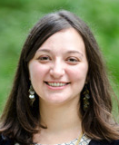
“There is no one easy answer. Not everything works for every student or every teacher or in every classroom. I am not an expert in your classroom or your students (or an expert in anything, actually!). This is not a conversation that needs to or should be relegated to only Social Studies and English Language Arts classrooms.”
Dr. Alyssa Hadley Dunn
Emory University

Slide 46
Cooperative Groups
We will explore resources created for teachers to facilitate difficult conversations.
We will use traditional cooperative group roles to engage in the exploration.
When you arrive in your groups decide who will serve in each role on the next slide.

Slide 47
COOPERATIVE GROUP ROLES
Leader -Makes sure that every voice is heard; keeps work focused work on the learning task
Recorder -Compiles group members’ ideas on collaborative graphic representations
Time-Keeper -Encourages the group to stay on task; keeps group aware of how much time is left
Reporter -Presents the group’s finished work to the class
Materials Manager -Clarifies the supplies needed or requests help if the group needs it

Slide 48
Group Process – Steps Involved
20 minutes
Priming (3 minutes)
Find the Resources for Teachers for ”Days After” link in the chat.
Processing (15 minutes)
Take 8 minutes of protected time to explore the site.
Note helpful/powerful/useful resources embedded within the site.
Take 7 minutes to share what you found with your group members.
Retaining for Understanding (10 minutes)
Choose one helpful/powerful/useful resource to share with the whole group.
Share the resource and why you selected it.
If time runs out, please add your suggested resource in the chat.

Slide 49
Grab That
Group Process
Cooperative Group Roles

Slide 50
Introductions
Let’s take a BREAK
10 minutes

Slide 51
Part Three: Listening to Our Students

Slide 52
Text-based Discussion
Text: Students Respond to Adults’ Fixation on “Learning Loss”
Source: Education Week, Larry Ferlazzo
Date: February 02, 2021
https://www.edweek.org/leadership/opinion-students-respond-to-adults-fixation-on-learning-loss/2021/02
Protocol: Anticipation Guide

Slide 53
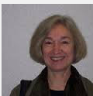
Anticipation Guide
Dr. Denise Nessel Thinking Strategies for Student Achievement

Slide 54
Anticipation Guide

Slide 55
Large Group Discussion
I will:
Stop Screen Share
We will:
Enter Gallery View
For Consideration:
“Let’s not return to our previous ways of educating students. We have an opportunity to think and plan differently in this moment. To build a system that is responsive to the needs of the students it purports to serve. A first step in doing so is to listen to our students.”

Slide 56
Introductions
#
Stamp the Chat
word, phrase or statement that expresses what you are thinking, feeling, or connecting to

Slide 57
Grab That
Anticipation Guide
Community Conversation

Slide 58
Community Conversation
Collective Connections

Slide 59
The Capacity Equation
Let’s deconstruct the I Am experience using the System Equity Tools. (5 minutes)

Slide 61
Who’s in the Room?
Please type your first and last name, role/title and school in the chat.

Slide 62
Remember who you are.
Remember who we are.
Lead with the fierce urgency of now!

Slide 63
Final Reflection
Access the link to the Google Form in the chat.
nuatc.org

Slide 64
yjackson.poc@gmail.com
Thank you, Osseo!
nuatc.org
Upcoming Forum Date: April 17th

