Slide 1
Signs of Our Times (3 hours; 3 Focus Areas)
NUA/CLEAR Instructional Mediators Forum January 16, 2021
Session Collaborators
Maureen Araya-Osseo Area Schools
Stefanie Rome-NUA
Hannah Storm-Osseo Area Schools

Slide 2
Today: In 3 Parts
Signs of the Times: Preserving Our Peace
Focus on Relationships: NUA Foundations (toward a shared knowledge base)
Cognitive & Neuroscience
Equity Consciousness
Signs of the Times: Surrounding Our Students
Focus on Trauma Informed Practices
Pandemic Related Stress
Signs of the Times: Lifting All Voices
Focus on Processing World Events
Strategies for “Days After"
NUA Foundational Principles

Slide 3
For the Good of the Group
It would be great to see all of you. If possible, please enable your video
We will use Breakout Rooms for collaboration and conversation
Take pictures of the steps involved before we break away
We want to be able to refer to you by name
Click on Participants or in your Zoom box
Click “More”
Click “Rename”
Add name, school, grade level
Session Documents
Google folder: Link to NUA/CLEAR Saturday Forum 1: Resources
at the top of the Chat
Session Recording
This session will be recorded

Slide 4
Who’s in the Room?
Please type your first and last name, role/title and school in the chat.

Slide 5
Type # and then add a word, phrase or statement that expresses what you are thinking, feeling, connecting to in that moment.
# Stamping the Chat
Throughout the session, we will use the Chat window to process and make connections as a community.
When you see the # symbol, go to your chat feature and “stamp it”.
Example: #Strategize the Chat
Notes:
Pairing: Put numbers on the back of the CLEAR handout and have the teachers find their partners in the room for the Cultural Pizza activity.

Slide 6
The Power of the Collective
“Chat Monitor” – Each time we Stamp the Chat, allow one minute for #s to populate. Find 2 entries that resonate with you. Share them with the group and make space for a brief discussion.
“Quote Illuminator” – Read session quotes aloud as they appear on the screen and make space for a brief discussion.

Slide 7
Introductions
Passing The Power
When you see the word “Switch!” on the screen, pass the power to someone in the group to take your place.

Slide 8
Today’s Flow
dialogue
Introductions
&
Overview
Preserving
Our
Peace
Surrounding
Our
Students
Lifting
All
Voices
Next Steps
Final
Reflection
&
Feedback
discussion
discourse

Slide 9
Part One: Preserving Our Peace

Slide 10
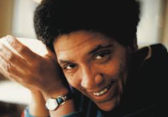
Introductions
“Caring for myself is not self-indulgence. It is self-preservation and that is an act of political warfare.”

Slide 11
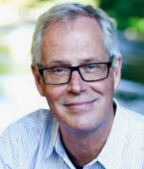
Introductions

Slide 12
Introductions
#
Stamp the Chat
word, phrase or statement that expresses what you are thinking, feeling, or connecting to

Slide 13
@ the Foundation
foundational principles of NUA

Slide 14
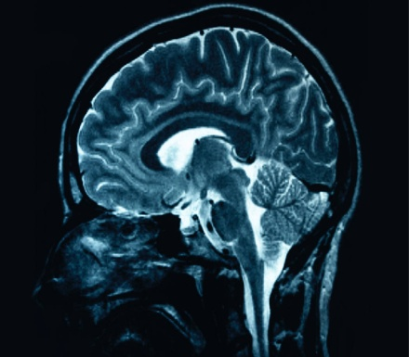
Gifting Our Students
Cognitive Science
Neuroscience
POTENTIAL = POSSIBILITY
@YJacksonNUA
Notes:
G/T: belief, strengths/ invitation, enrichment, opportunity, support
Science of Learning:
.
Emancipation - when we remember the belief we had and rekindle our confidence we emancipate our selves to enjoy our gifts thereby emancipating students’ perceptions of themselves
Revolution – to transform -,stand up against the control around deficit culture with confidence in our ability to inspire, elicit and build on strengths connecting with the brilliance not through scripted programs but the empirical research we have taking what we know about enrichment and relationships and substantiate with the neuroscience about intellectual development and growth

Slide 15
PEDAGOGY of CONFIDENCE
The fearless expectation and support for all students to demonstrate high intellectual performance (H.I.P.)

Slide 16
On Building Relationships
“No significant learning can take place without significant relationships.”
-Dr. James Comer

Slide 17
Community Builder
I Know for Sure

Slide 18
I Know For Sure- The Steps
Take 1 silent minute to reflect on a powerful quote that drives your practice and why it resonates with you.
Write about your quote using this frame.
____________ said “____________________________.”
I know, for sure, that ____________________________.

Slide 19
I Know For Sure- An Example
Bob Marley said, “You don’t know how strong you are until being strong is your only choice.”
I know, for sure, that educators are amazingly strong and remarkably resilient. The world changed and we pivoted to ensure that children get the education they’re entitled to.

Slide 20
I Know For Sure- The Discussion
5 minutes
Meet in Breakout Groups
Share your quotes and what you know for sure.
If you have time, discuss how this Community Builder might be used in practice.

Slide 21
Introductions
#
Stamp the Chat
word, phrase or statement that expresses what you are thinking, feeling, or connecting to

Slide 22
Switch!

Slide 23
@ the Foundation
foundational principles of NUA

Slide 24
NUA-Why We Do It
Self Direction
Self Actualization
A
I
I
C
S
C
T
Joe Renzulli

Slide 25
NUA-What We Do
Transform teacher practice to optimize the intellectual capacities of all children.
eliminating
discovering
equity
cultivating
removing
interrupting
creating

Slide 26
Introductions
On Educational Equity

Slide 27
“Equity in education requires putting systems in place to ensure that every child has an equal chance for success.
–Dr. David Hyerle
Creator of The Thinking Maps

Slide 28
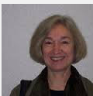
Key Word Prediction
Steps Involved
Teacher puts topics on board along with 8-20 words, numbers
Students speculate on how terms relate to topic.
Groups share and debate hypothesis; teacher moderates, does not give hints.
Students experience text to get more information.
Students review what what they have learned, how their thinking has changed.
Dr. Denise Nessel

Slide 29
utility
deliberate
learn
practice
access
focus
outcomes
excellence
different
goals
Educational Equity
results
outcomes
least experienced
parents
equal
pressure
political
exacerbate
resources
high needs

Slide 30
Meet in Breakout Rooms
7 minutes
Join your group
Make predictions about how the terms relate to the topic
Share “the why” for each of your predictions

Slide 31
Educational Equity
Dr. Pedro Noguera
Professor Teaching and Learning
NYU Steinhardt School of Culture, Education, and Human Development
3 minutes and 19 seconds

Slide 32
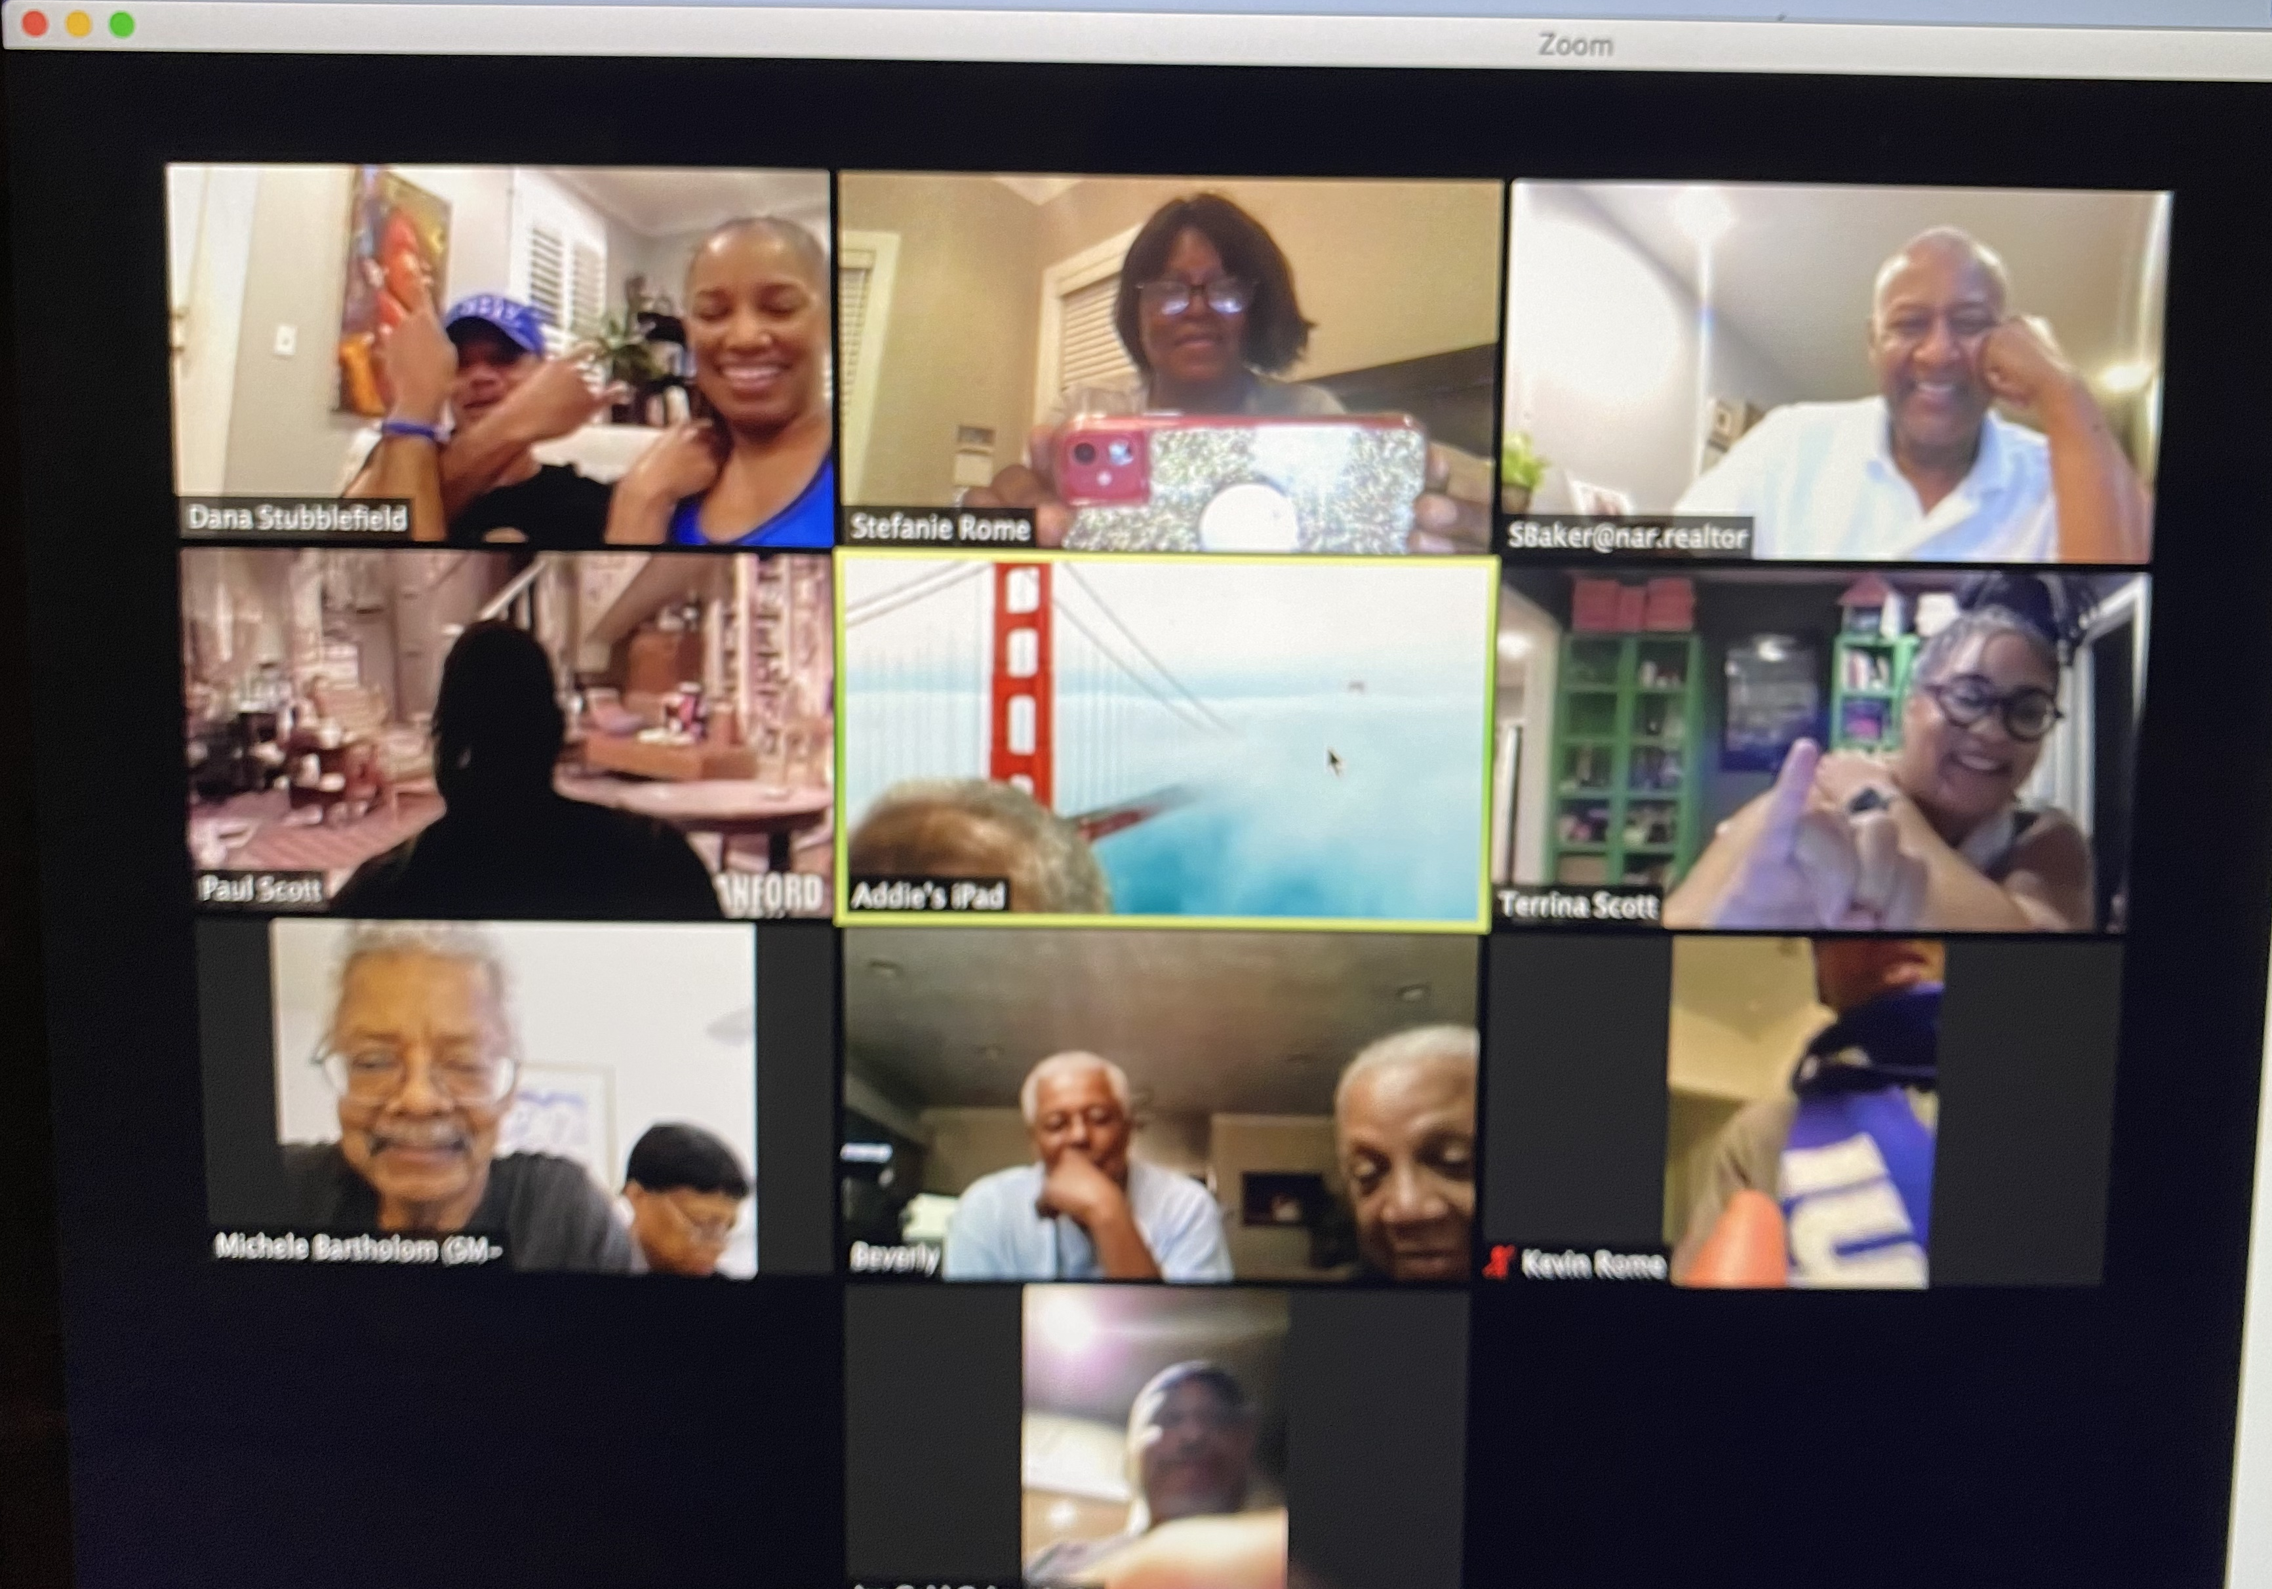
Large Group Discussion
I will:
Stop Sharing My Screen
We will:
Enter Gallery View
For Discussion:
Considering what we can control, what does educational equity look like in a virtual world?
4 minutes

Slide 33
Introductions
#
Stamp the Chat
word, phrase or statement that expresses what you are thinking, feeling, or connecting to

Slide 34
Community Builder
Who’s Coming With You

Slide 35
Who’s Coming With You?
Take 30 seconds to consider your ancestors (those who have lived and led before you).
Choose someone that you want “bring” with you into the new year.
Considerations:
Why you are bringing this person?
What gift does she or he give you?
How will he or she help you in the new year?
Use this frame to write about who you’re bringing.
I am bringing _____________________ because _______________.

Slide 36
I am bringing Nelson Mandela because he reminds me to believe in the “power of the collective”.
Example

Slide 37
Meet in Breakout Rooms
6 minutes
Join your group
Share who’s coming with you and why
If you have time, share how this Community Builder might be used in practice

Slide 38
Introductions
Let’s take a BREAK
10 minutes

Slide 39
Part Two: Surrounding Our Students

Slide 40
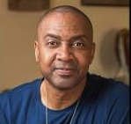
nuatc.org

Slide 41
Switch!

Slide 42
Text-Based Discussion Pre-Session Reading
Text: Trauma-Informed Practice Is a Powerful Tool. But It’s Also Incomplete
by Simona Goldin & Debi Khasnabis — February 19, 2020
Protocol: Powerful Words

Slide 43
Powerful Words – The Preparation
Priming (3 minutes)
Find the text
Identify a clean surface to draw/write on
Processing (10 minutes)
Take 7 minutes of protected time to read/revisit the text
Highlight powerful passages and salient points
Retaining for Understanding (3 minutes)
Choose one powerful word to express how we can interrupt the impact of trauma on student success.
Write the word, boldly, in the center of your page
Decorate the area around your word in any way you choose

Slide 44
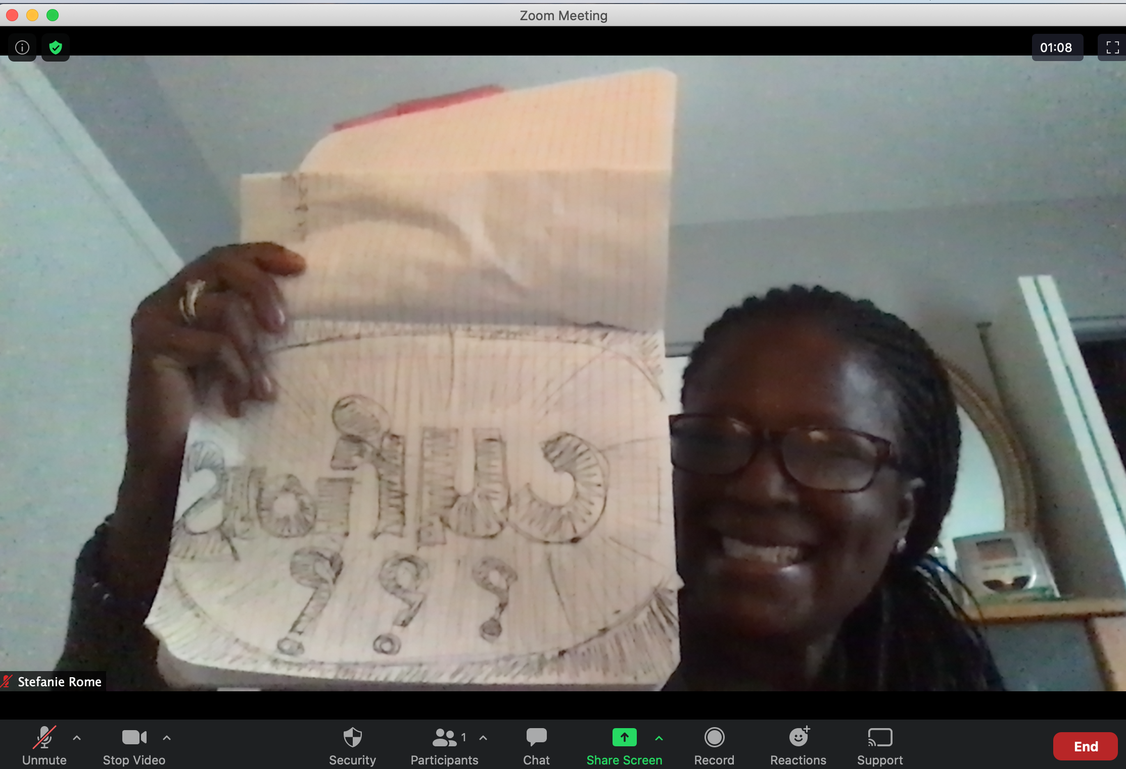
Powerful Words – The Conversation
At the count of “3” hold your powerful word up to your camera word so that it fits in the center of your screen:
Hold your word in place for 20 seconds
Take in the Powerful Words of your colleagues
Join in the Large Group Discussion

Slide 45
Large Group Discussion
I will:
Stop Screen Share
We will:
Enter Gallery View
For Consideration:
How might we impact the systems that perpetuate trauma on students?

Slide 46
Introductions
On Traumatic Stress
“Traumatic stress, whether triggered by one-time events like natural disasters or an act of violence, or through long-term experiences like racism or a pandemic, can impact a student’s mental, physical, and emotional health. But research shows that relationships and stability go a long way to preventing the effects of trauma.”

Slide 47
Introductions
#
Stamp the Chat
word, phrase or statement that expresses what you are thinking, feeling, or connecting to

Slide 48
Switch!

Slide 49
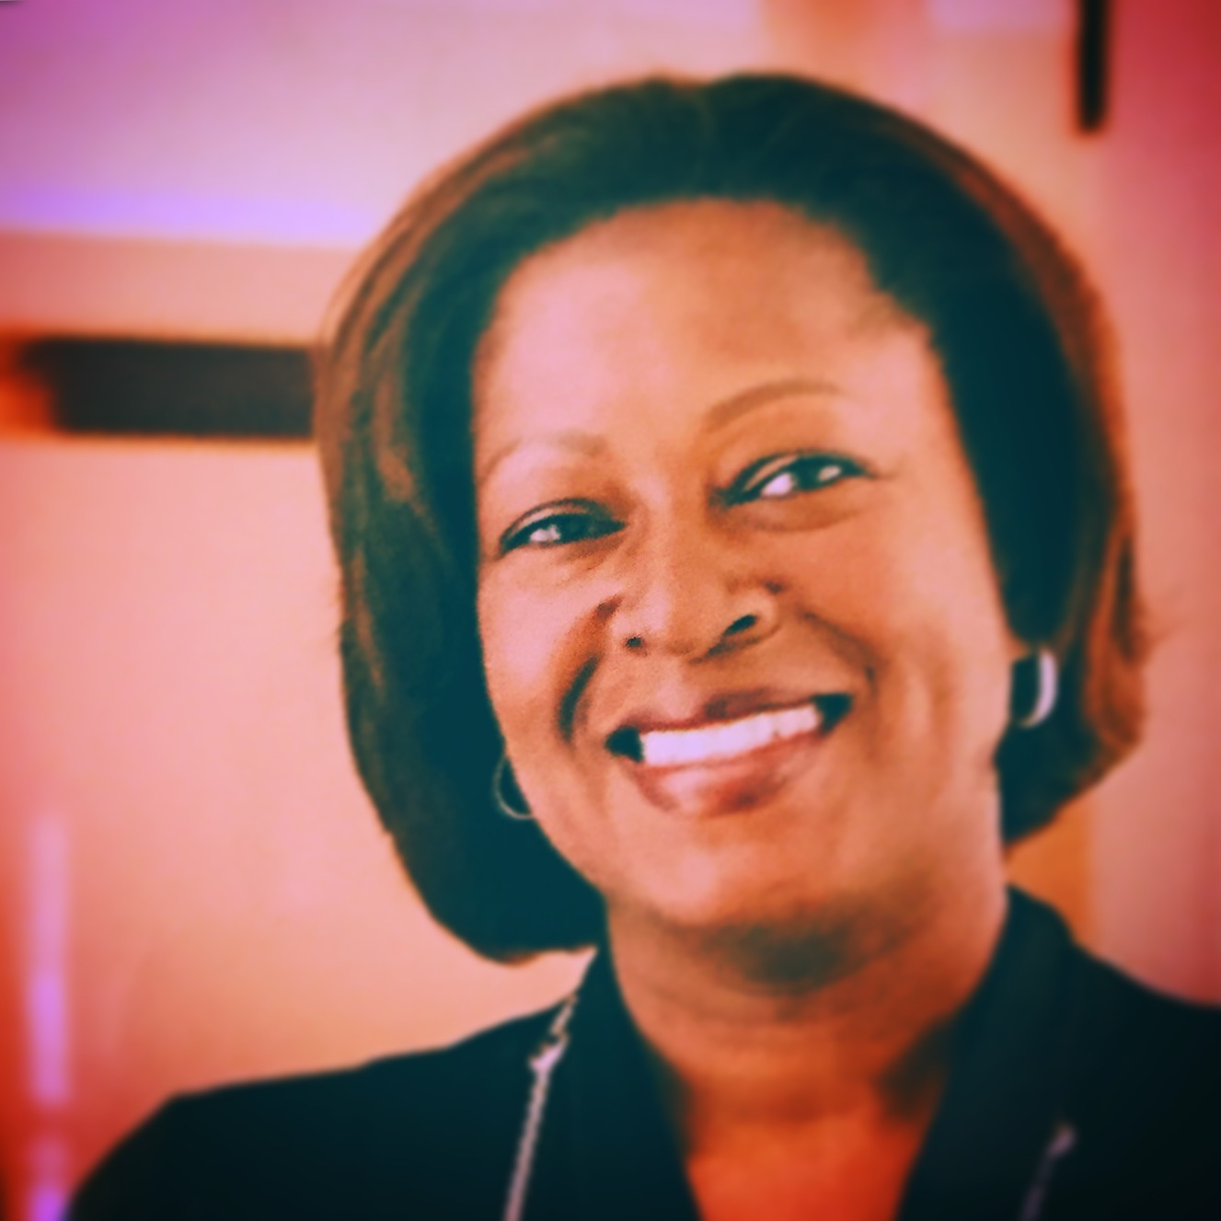
View & Capture
Stefanie Rome
Identify the View & Capture Frame in the folder for today’s session, or create the frame wherever you are taking notes

Slide 50
View & Capture Frame
What is a Trauma Informed Program? (definition)
What can schools/educators do?
(specific strategies & practices)
What are the benefits?
(for students, teachers, systems)
How has the pandemic informed what’s needed?

Slide 51
View and Capture
Gathering Information
We will experience the text twice.
1. Take it in.
2. View and Capture.
Considerations:
Capture examples that might answer each of the guiding questions in your frame.
Write words, draw pictures in the boxes as evidence.

Slide 52
View & Capture Frame
What is a Trauma Informed Program? (definition)
What can schools/educators do?
(specific strategies & practices)
What are the benefits?
(for students, teachers, systems)
How has the pandemic informed what’s needed?

Slide 53
Introductions
On Being Trauma-Informed
“Becoming trauma-informed is a years-long, ongoing process. From teaching coping strategies to encouraging professional development on social-emotional wellbeing, there are several approaches educators can adopt to incorporate trauma-sensitive practices.”

Slide 54
Large Group Discussion
I will:
Stop Sharing My Screen
We will:
Enter Gallery View
For Discussion:
Considering the concepts raised in the article, and accepting that there are many factors beyond our control,
How might we work together to support our students here in Osseo?
10 minutes

Slide 55
Introductions
#
Stamp the Chat
word, phrase or statement that expresses what you are thinking, feeling, or connecting to

Slide 56
Switch!

Slide 57
Part Three: Lifting All Voices

Slide 58
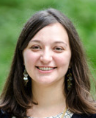
“There is no one easy answer. Not everything works for every student or every teacher or in every classroom. I am not an expert in your classroom or your students (or an expert in anything, actually!). This is not a conversation that needs to or should be relegated to only Social Studies and English Language Arts classrooms.”
Dr. Alyssa Hadley Dunn
Emory University

Slide 59
Group Process – Steps Involved
20 minutes
Priming (7 minutes)
Find the Resources for Teachers for ”Days After” link in the shared folder
Processing (10 minutes)
Take 5 minutes of protected time to explore the site
Note helpful/powerful/useful resources embedded within the site.
Take 5 minutes to share what you found with your group members
Retaining for Understanding (10 minutes)
Choose one helpful/powerful/useful resource to share with the whole group.
If time runs out, please add your suggested resource in the chat.

Slide 60
Who’s in the Room?
Please type your first and last name, role/title and school in the chat.

Slide 61
Let’s be here for each other.
Let’s check on one another.
nuatc.org
Let’s remember to care for ourselves!

Slide 62
Final Reflection
Access the link to the Google Form in the chat.
nuatc.org

Slide 63
yjackson.poc@gmail.com
Thank you, Osseo!
nuatc.org
Upcoming Forum Dates: March 13th, April 17th

