Slide 1
Signs of Our Times (3 hours; 3 Power Circles)
NUA/CLEAR Instructional Mediators Forum April 17, 2021
Session Collaborators
Maureen Araya-Osseo Area Schools
Stefanie Rome-NUA
Ann Schwartz-NUA

Slide 2
Who’s in the Room?
Please type your first and last name, role/title and school in the chat.

Slide 3
Type # and then add a word, phrase or statement that expresses what you are thinking, feeling, connecting to in that moment.
# Stamping the Chat
Throughout the session, we will use the Chat window to process and make connections as a community.
As you feel led…
Example: #Strategize the Chat
Flashback
Notes:
Pairing: Put numbers on the back of the CLEAR handout and have the teachers find their partners in the room for the Cultural Pizza activity.

Slide 4
The Power of the Collective
As you feel led…
“Check the Chat” – Periodically check the chat. If you find comment interesting or have a question, share them with the group and make space for a brief discussion.
“Quotable Quotes” – Read session quotes aloud as they appear on the screen and share why/how it resonates with you, making space for a brief discussion.
Flashback

Slide 5
Saturday: In 3 Circles
Signs of the Times: Affinity Circles
Focus on Healing & Hearing
Signs of the Times: Issue Circles
Focus on Adults’ Fixation on ‘Learning Loss’
Signs of the Times: Action Circles
Focus on What’s Possible (Crowd Sourcing)
NUA Foundational Principles

Slide 6
Today’s Flow
Introductions
&
Overview
Signs of Our Times
The Tree Map
Affinity Circles
4 Articles
3 Considerations
Application
Artifact Sharing
Deconstruction
Issue Circles
Artifact Sharing
Action Circles
Artifact Sharing
dialogue
discussion
discourse
Edification

Slide 7
On Building Relationships
“There can be no significant learning without significant relationship.” -Dr. James Comer
Schools where students and teachers share a high-level of mutual trust and respect, and where relationship exists among the principal and school staff are better organized to improve. University of Chicago - 5Essentials
Spending time to save time.

Slide 8
NUA on Culture
Whatever is meaningful and relevant…

Slide 9
“Culture, experiences, and previous knowledge structures (i.e., cognitive schema) shape and determine how new and previous learning is connected. Students construct new knowledge through a dynamic process between prior knowledge and new experiences.” -Carol Ann Tomlinson
On Knowledge Construction

Slide 10
Community Builder
Signs of My Times

Slide 11
Tree Map

Slide 12
Signs of My Times
Create a Tree Map in your notebook with the following categories:
Signs of My Times
Events
People
Things
Music
Slogans
Sayings

Slide 13
Signs of My Times
Think about the adolescent phase of your life (your teenage years).
Reflect on the factors that influenced your life during that time, specifically as it relates to any significant: events, people, things, music, slogans and sayings.
Add that information to your Tree Map.

Slide 14
Signs of My Times
Share the information on your Tree Map with your group members.
Identify one item from your Tree Map that is particularly significant and try adding something to your Zoom box/name that represents that item.
If it is your destiny, share what you added to your Zoom box, and why it is significant, with the whole group.

Slide 15
Grab That
Signs of My Times

Slide 16
Session Analysis & Deconstruction

Slide 17
Designing and Planning for Effective Instruction
A Guide for Teachers & Facilitators
Notes:
This is a revision of a document first used at the COS planning meeting in September 2006.
The intent of the revision is to provide a framework for mentors as they plan their seminars and other activities. The structure allows a range of choices as they make their decisions.
The assumption here is that it’s best to have a lesson-oriented session built around a text of some sort, which might be print, pictorial, and/or video. Such a lesson-oriented session is best planned within a before-during-after framework so that it simulates what teachers might actually do in their classrooms.

Slide 18
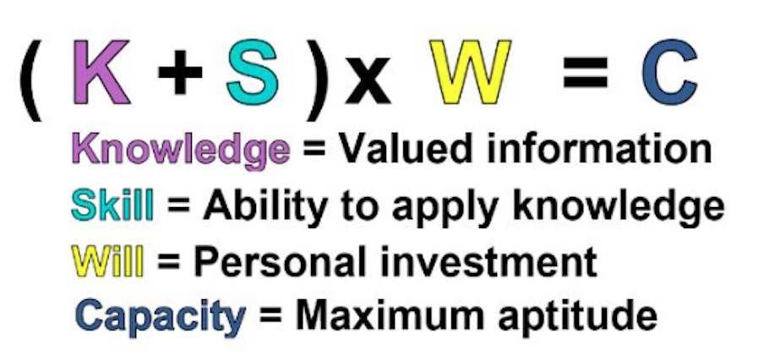
Pedagogical Considerations Crosswalk
Let’s examine pedagogy development & deconstruct our session using the System Equity Tools.
Pedagogy is…
Environment
Content
Instruction

Slide 19
Designing and Planning for Effective Instruction
A Guide for Teachers and Facilitators
Notes:
This is a revision of a document first used at the COS planning meeting in September 2006.
The intent of the revision is to provide a framework for mentors as they plan their seminars and other activities. The structure allows a range of choices as they make their decisions.
The assumption here is that it’s best to have a lesson-oriented session built around a text of some sort, which might be print, pictorial, and/or video. Such a lesson-oriented session is best planned within a before-during-after framework so that it simulates what teachers might actually do in their classrooms.

Slide 20
3 Phases of Learning
Priming
Processing
Retaining
For
Understanding

Slide 21
Step 1: Deciding on Lesson Content (WHAT I will teach)
Text?
(print, video, etc.)
Concept or Theme?
Discipline?
Information focus?
Skill focus?
Notes:
The first step in designing a lesson-oriented seminar is to make a series of closely-related decisions about the CONTENT, that is, the WHAT of the workshop. The five ovals here represent content decisions. Your thinking will go back and forth among these decision points, which are interrelated and are made by experienced mentors almost simultaneously.
For example, you may first make decisions about your skill focus, such as deciding that you want to concentrate on vocabulary, perhaps with particular attention to English language learners (ELLs). If this is your starting point, you then need to think about what text you will use to demonstrate how to develop vocabulary, what discipline is associated with that text, what information is contained in that text that will be a focus in the workshop, and what concept will provide the context for the vocabulary lesson.
OR, you may first make decisions about what information to focus on within a particular discipline. This is a typical starting point for teachers, e.g., the events leading up to the writing of the Declaration of Independence or the causes of thunderstorms or the characteristics of a genre or literature. If this is your starting point, you then need to think about what text(s) you will use to convey that information, what concept you will hook the information to, and what skills to address.
OR, you may first make decisions about the text you want to use. This, too, is a starting point for many teachers, especially those who rely heavily on their textbook. Once you select your text and decide what discipline is most closely associated with it, you then need to decide what the information focus will be, what concept you will hook the information to, and what skills you will address.
Using this schematic to represent the thinking that goes into the CONTENT of a workshop enables everyone to begin at their most comfortable starting point. Some people, both mentors and the teachers with whom they work, think in terms of skills first; others start with information to be covered; others prefer starting with a broad concept or theme; others start with a text; others think in terms of doing “a language arts workshop” or “a math workshop” or “an ELL workshop.” It doesn’t matter where you start as long as you make deliberate decisions in each of the five areas.

Slide 22
Step 2: Deciding on Lesson Activities (HOW I will teach)
PRIMING activities
PROCESSING
activities
RETAINING FOR MASTERY
activities
CONNECT TO LEARNERS’
FRAMES OF REFERENCE
Notes:
When you have decided on your content, the next step is to decide HOW you will teach the content, that is, what PEDAGOGY you will use to demonstrate effective instruction. This is the time to use the before-during-after framework and to focus on the activities that will most effectively make the points you want to make about learning and teaching.
A focus of NUA workshops is the ongoing connection of content and activities to the learners’ frames of reference, which includes their personal histories, their culture, their language, their interests, their preferences, and so on. So in deciding on activities, keep that focus in mind. For example, if the workshop is to have a focus on ELLs, then the before-, during-, and after-learning activities should illustrate good pedagogy for ELLs.
You are not actually doing a Flow Map of the workshop at this point but are simply thinking of what strategies you want to use in the workshop and making tentative decisions about which ones you will use before, during, and after the learners engage with the content.

Slide 23
Step 3: Deciding How To Differentiate
How will I build differentiation into the seminar?
Possible areas of differentiation, which are inter-related:
CONTENT
PRODUCT
PROCESS
Notes:
For example, as you think about the CONTENT of the workshop, you also need to think about the learners who will be involved with this content. They will be different, with different strengths and needs, so you need to consider how your instruction will be differentiated.
You may decide to differentiate the CONTENT by obtaining or preparing different texts on the same topic, written on different reading levels, so that you can demonstrate how learners at different reading levels can read about the same topic at the same time. You might also have a video text or a graphic text as an alternative to written texts.
OR you may decide to let groups choose the PROCESS they will use to learn or to represent their learning. For example, you might invite learners to choose between writing or drawing or talking in order to represent their learning at different points in the lesson. If a focus of the workshop is ELLs, then you will almost certainly want to differentiate the processes to illustrate how teachers can adapt their instruction to the needs of ELLs.
OR you may decide to give different groups different PRODUCTS to generate to demonstrate their learning, e.g., a skit that they write and perform, or a series of illustrations to represent the information, or a written and spoken poem. This, too, is a good way of differentiating learning when ELLs are among the learners.

Slide 24
Step 4: Deciding on Research/Rationale to Cite
What research will I use to support
my choice of content and activities?
How will I introduce the research/rationale in a
way that is memorable and engaging?
Notes:
When you have decided on your content and on the basic learning activities, you also need to decide what research references you will include in your seminar. For example, you may mention research as an aside during your presentation, or you may post memorable quotes from researchers, or you may summarize research on a handout. When thinking about this aspect of the seminar, it’s a good idea to cite research from the books the participants have been given.
Also consider how you will connect your seminar to NUA frameworks and concepts, e.g., Culture/Language/Cognition, High Intellectual Performance, The Pedagogy of Confidence, etc. You may at this point want to redesign some of your activities to incorporate more of this material.

Slide 25
Step 5: Deciding on the Flow
Create a tentative Flow Map to
represent decisions so far:
Notes:
After decisions are made about CONTENT and PEDAGOGY, the next step is to start thinking more deliberately about the flow of activities. That is, what you want learners to do first, what to have them do after that, and so on throughout the allotted time.

Slide 26
Step 6: Crafting Transitions
How will I make smooth transitions between activities?
T
T
T
T
Notes:
Transitions can be simple statements that move participants from one activity to the next, e.g., “Now that you have some questions in mind, let’s read the text to see if we can find some answers.” Or transitions can move from one activity to another while also commenting on the preceding activity, e.g., “Jensen’s book stresses the importance of priming, which is the purpose of the activity we just finished…” Effective transitions give participants the sense of moving seamlessly from one activity to the next.

Slide 27
Step 7: Building in Time for Reflection
At what points will I stop for reflection?
What will participants do to reflect?
T
T
T
T
R
R
Notes:
It’s important to allow several opportunities for reflection during the seminar. Participants can can talk in pairs about what they’ve learned, write in their notebooks, generate a Thinking Map, or engage in other such activities that will help them internalize what they are learning. Reflection activities should be planned carefully and introduced strategically to provide a change of pace as well as time for internalizing.

Slide 28
Step 8: Deciding on Assessment
How will I assess what the learners have learned?
How will I do this?
T
T
T
T
R
R
A
A
Notes:
Assessment can be as simple as a standard evaluation form handed out at the end or may include other forms of evaluation during the seminar or at the end, e.g., learning log entries, self-assessments, Thinking Maps, or quizzes.

Slide 29
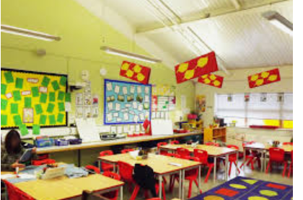
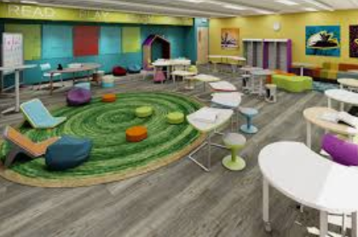
Step 9: Organizing the Room
How will I organize the furniture in the room?
How will the students sit?
What will be on (or put on) the walls?
Notes:
You may not have any information about your seminar room until you see it the day of the seminar. However, you can give thought to how you want the room to look and what you will have to prepare for the room.

Slide 30
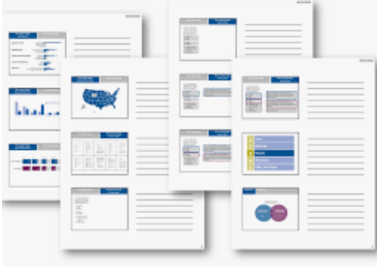
Step 10: Decisions about Handouts
What information will I include in handouts?
How many handouts will I have?
What credits do I need to give?
How will I make the handouts clear and attractive?
When and how will I distribute them?

Slide 31
Summary of Decisions
Content
Pedagogy
Differentiation
Research
Sequence of Activities
Transitions
Reflections
Assessment
Room
Handouts
Notes:
Summary of decisions in a Flow Map

Slide 32
The High Operational Practices
Identifying and Activating Student Strengths
Building Relationships
Eliciting High Intellectual Performance
Providing Enrichment
Situating Learning in the Lives of Students
Integrating Prerequisites for Academic Learning
Amplifying Student Voice for Self-Directed Learning and Self Actualization

Slide 33
Pedagogical Considerations Crosswalk
Let’s deconstruct our session using the System Equity Tools.
Pedagogy is…
Environment
Content
Instruction
Connections?

Slide 34
Considerations?
Where have we experienced evidence of the System Equity Tools in our Saturday session work?
High Operational Practices?

Slide 35
Affinity Circles: Hope & Healing

Slide 36
Affinity Circles: What? & Why?
An affinity circle is a small group of people who support each other and work together to change the world.
Support and Community. Americans are increasingly isolated. Mainstream culture encourages us to be cut-off from each other, relying on money, corporate products, and screen time to fill our needs. Even as activists, we often act as individuals, rather than in solidarity with others.
Undermining consolidated power. Many of us have lost community-building skills, so we can relearn them by being part of a small, supportive group. These skills make us all better activists, organizers, and leaders.
.
Taking Action. Affinity groups support each other in taking “direct action,” such as attending a rally. Members take on different roles so everyone can participate.

Slide 37
Affinity Circles Text Selections
Groups 1, 2, 3
What Role Can the Education Community Play to End Racism and Begin Healing?
Group 4, 5, 6
Healing-Centered Schools: A Community-led Approach to Creating Safe and Healing School Environments
Group 7, 8, 9
Meditation Helps Lower Truancy and Suspensions
Group 10, 11, 12
Opinion: Letter to White People Black Americans Are Exhausted

Slide 38
ZOOM Breakout Rooms
To choose a breakout room:
Select “Join Breakout Room”
Select the room number or the topic that you wish to discuss.
For example, “Meditation”
To change the room you are currently in:
Select “Join Breakout Room”
Select the room number or the topic that you wish to discuss.
For example, “Strategies”
To go back to the main room:
Select “Leave” and “go to main room”

Slide 39
W3 - The Set Up
What I Read
What’s in My Head
What My Neighbor Said
What I Read (Saw) | What’s in My Head | What My Neighbor Said

Slide 40
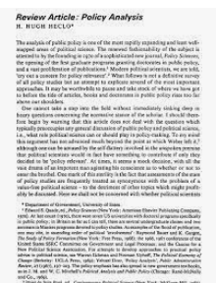
W3 – The Rhythm
What I Read | What’s in My Head | What My Neighbors Said
verbatim
free association
challenges, affirms, pushes you further

Slide 41
Grab That
W3
Affinity Circles

Slide 42
Artifact Sharing & Affirmation
Consider the work that you’ve done in your classrooms, buildings, offices since our Saturday sessions began.
Meet in your breakout rooms
Share any artifacts or stories related to implementation of our work with your group members.
Remember to affirm.
Consider:
Who is being affirmed?
What, specifically are you affirming?
Why is what you heard/saw affirmation worthy?

Slide 43
Issue Circles: Listening to Our Students

Slide 44
Text-based Discussion
Text: Students Respond to Adults’ Fixation on ‘Learning Loss’
Source: Education Week, Larry Ferlazzo
Date: February 02, 2021
Protocols: Anticipation Guide & Issue Circles

Slide 45
Anticipation Guide
Dr. Denise Nessel Thinking Strategies for Student Achievement

Slide 46
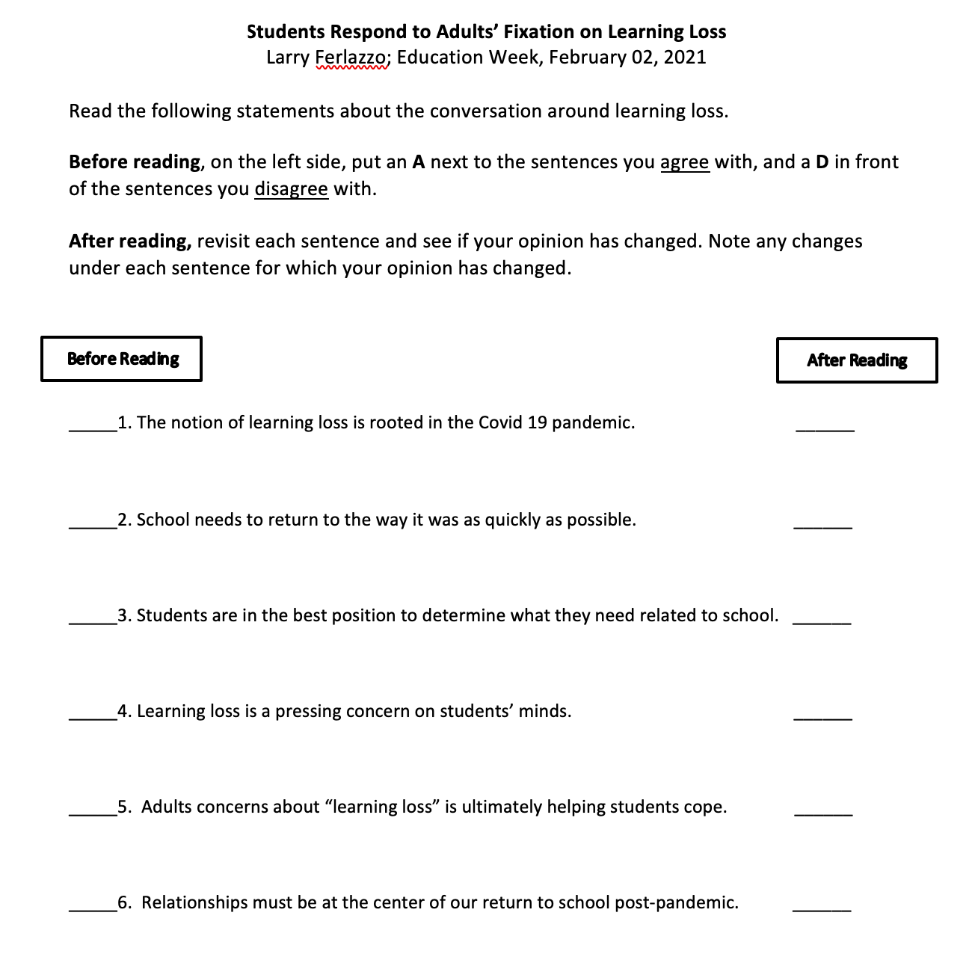

Slide 47
Anticipation Guide
Read the statements. (5 minutes) (link in the chat)
Decide whether you agree or disagree.
Meet in groups (discuss & debate).
Engage in the whole group discussion.
Read the text.
Discuss again as as whole group.
Has your thinking changed? How?

Slide 48
Issue Circles: Listening to Our Students

Slide 49
Issue Circles: What? & Why?
Issue Circles are small groups of people that empower students to develop personal responses that highlight their critical and in-depth thoughts about an issue or topic.
Issue Circles attempt to move students towards facilitating students’ personal responses from a close textual-based standpoint to an issue-based standpoint.
Issue Circles provide an approach towards initiating learner response in the classroom.
Issue Circles allow students to deepen their awareness of a given text and to intensify their participation in the act of critical response.

Slide 50
Issue Circles: Steps Involved
Small Groups - 3 rounds
Round 1 (10 minutes)
Identify a Scribe
Identify a Reporter
Read the text (5 minutes)
Scribe: Capture the thoughts of the group, in any way you choose, on the slide that corresponds with your group’s number.
Group: Discuss the following prompts:
What is the author’s primary message?
What is the students’ primary message?
What might educators do to demonstrate that we are listening?
Reporter: Share your group’s slide with the whole group.

Slide 51
Issue Circles: Steps Involved cont’d
SHIFT: You will receive the message “SHIFT” (in Zoom).
When you get the signal, shift your focus to the slide right below yours (Group 12, shift to Group 1’s slide).
Round 2 (7 minutes)
Read the thoughts of your colleagues.
Scribe: add any new insights or affirmation to the information already on the slide.
SHIFT: You will receive the message “SHIFT” (in Zoom).
Round 3 (7 minutes)
Read the thoughts of your colleagues.
Scribe: add any new insights or affirmation to the information already on the slide.
RETURN You will receive the message to return to the main session
Come back to the whole group
Reporter: Share the information on your group’s slide with the whole group.

Slide 52
Large Group Discussion
I will:
Stop Screen Share
We will:
Enter Gallery View
For Consideration:
“Let’s not return to our previous ways of educating students. We have an opportunity to think and plan differently in this moment. To build a system that is responsive to the needs of the students it purports to serve. A first step in doing so is to listen to our students.”

Slide 53
Grab That
Anticipation Guide
Issue Circles

Slide 54
Action Circles
Meet in your small groups
Choose a Scribe.
Use the Action Circles slide deck provided.
Consider our work together and the healing needed in the education space.
Consider each of the roles represented in our learning community.
Classroom Teachers
Building Leaders
System Leaders
Teacher Coaches
Community Members
Work together to generate specific, feasible, purposeful action steps that could be taken in each role.

Slide 55
Large Group Discussion
I will:
Stop Screen Share
We will:
Enter Gallery View
For Consideration:
“Let’s not return to our previous ways of educating students. We have an opportunity to think and plan differently in this moment. To build a system that is responsive to the needs of the students it purports to serve. A first step in doing so is to listen to our students.”

Slide 56
Grab That
Action Circles

Slide 57
The Capacity Equation
Let’s deconstruct the I Am experience using the System Equity Tools. (5 minutes)

Slide 59
Who’s in the Room?
Please type your first and last name, role/title and school in the chat.

Slide 60
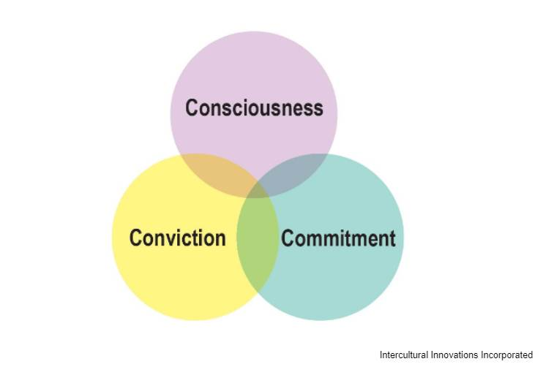
3 C’s of Change

Slide 61
Commitment Challenge
Implement at least one action item from our collective lists.
Contact at least one member of this learning community with an affirmation, word of encouragement, listening ear…just because.

Slide 62
Power of the Collective
Ask Me! I completed the Osseo/NUA Instructional Mediator Training 2021.

Slide 63
Final Reflection
Access the link to the Google Form in the chat.
nuatc.org

Slide 64
yjackson.poc@gmail.com
Thank you, Osseo!
nuatc.org
Until we meet again…

