Slide 1
Difficult Conversations: Part 2
Robert Seth Price, Senior Scholar
National Urban Alliance
April 16, 2021

Slide 2

Difficult Conversations
Any conversations that people don’t want to talk about

Slide 3

Difficult Conversations
Involve feelings

Slide 4

Pedagogy of Confidence
Situating Learning in the Lives of Students

Slide 5
Qualities
Attributes
Dispositions
Vulnerable
Relationships
Inquiry (Ask Questions)
Cultural Frames of Reference
Actions
Access Resources
Reflective

Slide 6
Qualities
Attributes
Dispositions
Vulnerable
Relationships
Inquiry (Ask Questions)
Cultural Frames of Reference
Actions
Access Resources
Reflective

Slide 7

?
Powerful Questions
Object • Concept • Image • Video • Song • Lyrics

Slide 9


Experiences, Schema
Cultural Frame of Reference
Cultural Frame of Reference

Slide 10
Thinking Maps as a Language
Describing in Context
Brainstorming
Comparing
& Contrasting
Categorizing
Describing
Sequencing
Cause and Effect
Whole / Part
Analogies
Relationships
Notes:
Back to thinking with Thinking Maps — organizing thinking. Circle map for brainstorming — then organize…

Slide 11
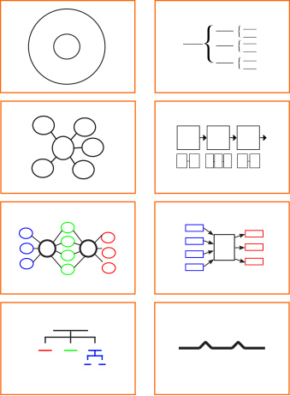

Schema
—text to text
—text to self
—text to world

Slide 12
Intentionality
Listening
Actions
With Whom?
For Whom?
The Why?

Slide 13

Actions
Doing
Reading
Inspiring Hope
Building Bridges
Of a Common Goal
With Choices

Slide 14
Causation: Cause / Effect Map + Frame of Reference
Causes — Input
event
Effects / Outcomes
Racism
Doing • Reading • Inspiring Hope • Regularity • Building Bridges • Your Actions

Slide 15
Step 1
Acknowledge that feelings are involved
Try to understand one’s feelings
Share one’s feelings clearly

Slide 16
Step 2
Difficult conversations are tied to one’s identity
  May threaten one’s identity
  May challenge one’s identity
  May question a person’s competency

Slide 17
Step 3
Acknowledge one’s contribution to the problem
Don’t try to control other’s reactions

Slide 18

Step 4
Decide when it is best to let go or to have the difficult conversation
  Do not take responsibility for fixing the conversation
  Remember that the other party has limitations too
  Separate the issue from your identity
  Remember that you can let go and still care about the “issue”

Slide 19
Step 5
Start the conversation in a third-party voice (e.g., People, others, humans, educators, Americans, etc.)
Avoid judging the other party with your words, posture, and body language

Slide 20

Step 6
Listen

Slide 21
Step 6a
Listening is crucial
Be curious and concerned for the other person
Ask open questions
Ask for concrete information
Ask questions regarding:
What happened?
What should happen?
Who is to blame?

Slide 22
Step 6b
Give the person the right to not answer your questions
Ask a question—do not make statements
Do not cross examine your counterpart
Paraphrase what the other person says to check your understanding
Acknowledge the power and importance of the other person’s feelings

Slide 23
Step 7
Express
yourself
Do not attempt
to prioritize your feelings over others
Do not present
your views as the “truth”
Avoid
language: always and never

Slide 24
Techniques to Keep the Conversation Going
Reframe
Listen
Naming the dynamic (point out digressions, interruptive behaviors, denied emotions)

Slide 25

Reading
Books
Researching for Articles
Living Histories
Shared Experiences
Accessing Resources

Slide 26
The Hard Part
People will disagree
Try to problem solve when possible
Think about what will it take to persuade the other person and what it will take to persuade you
Step into their shoes and ask them to step into your shoes
Ask: What would you do in my position?
Maybe you will resolve this or you just may have to walk away

Slide 27
As Professional Colleagues for the Students
Initiate a Difficult Conversation
Collaborate with a Peer

Slide 28
For Students in the Classrooms
Pedagogy
Content

Slide 29

Action Today?
Specific
Why
Reflection

