Slide 1
Pedagogy of Confidence Difficult Conversations
Fair Oaks Elementary
March 17, 2021
National Urban Alliance
www.nuatc.org
Robert Seth Price
www.eggplant.org • robert@eggplant.org

Slide 2
Difficult Conversations
Equity Consciousness
Equity Mindfulness
Equity Call to Action

Slide 3
www.pedagogyofconfidence.net

Slide 4
*HOPs
^{High Operational Practices} of the Pedagogy of Confidence support and enhance equity:
Identifying and activating student strengths
Eliciting high intellectual performance *HIPs
Integrating prerequisites for academic learning
Situating learning in the lives of students
^{Building relationships}
^{Providing enrichment}
^{Amplifying student voice}
www.pedagogyofconfidence.net
Belief and Belonging
www.nuatc.org
Notes:
Understanding from research and data, doing with practical models and strategies by practicing for expertise and mastery

Slide 5
Is there a current pressing issue in our country that would require a difficult conversation to address it?

Slide 6
Is there a current pressing issue in our country that would require a difficult conversation to address it?
Why is it so difficult to discuss this issue?

Slide 7
Actions
Creating Equity
Experiences in K-12 Influence
Beliefs, Actions and Outcomes

Slide 8
Vocabulary Terminology, Language
Schema Experiences, Connections
Cultural Frame of Reference Who We Are

Slide 9
It is not our differences that divide us. It is our inability to recognize, accept, and celebrate those differences.
~Audre Lorde

Slide 10
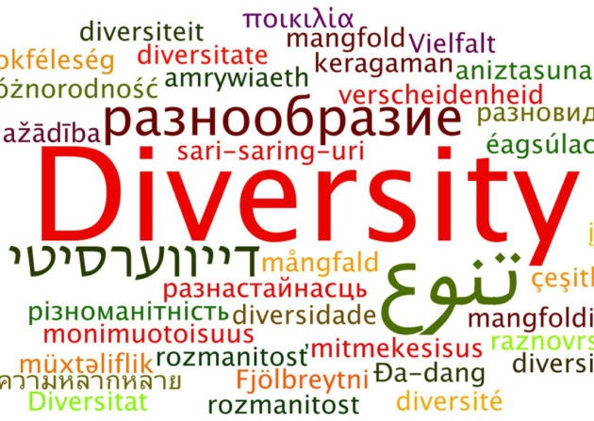
Terminology: Speaking the Same Language

Slide 11
How do you define diversity?
How do you embrace diversity?

Slide 12
Language
Matters

Slide 13
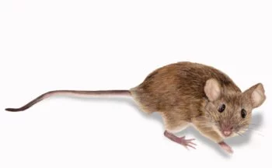
Vocabulary Terminology Language Schema

Slide 14
Deficit-minded Equity-mindedness
Deficit-minded Equity-mindedness
Disadvantaged
Poor
At-risk
Non-White
Underserved
Impoverished
Marginalized
Black/African American, African, Latinx, Asian, Indigenous, BIPOC, international, domestic, etc.
Unprepared
Minority (racial)
Low performing
Diversity
Underserved
Racially minoritized
Underserved
State race/ethnicity

Slide 15
It is important we do not pathologize differences.

Slide 16
Use Inquiry:
Powerful Questions
Shared Inquiry
Guiding Questions
Clarifying Questions

Slide 17
?
Powerful Questions
Object • Concept • Image • Video • Song • Lyrics

Slide 18
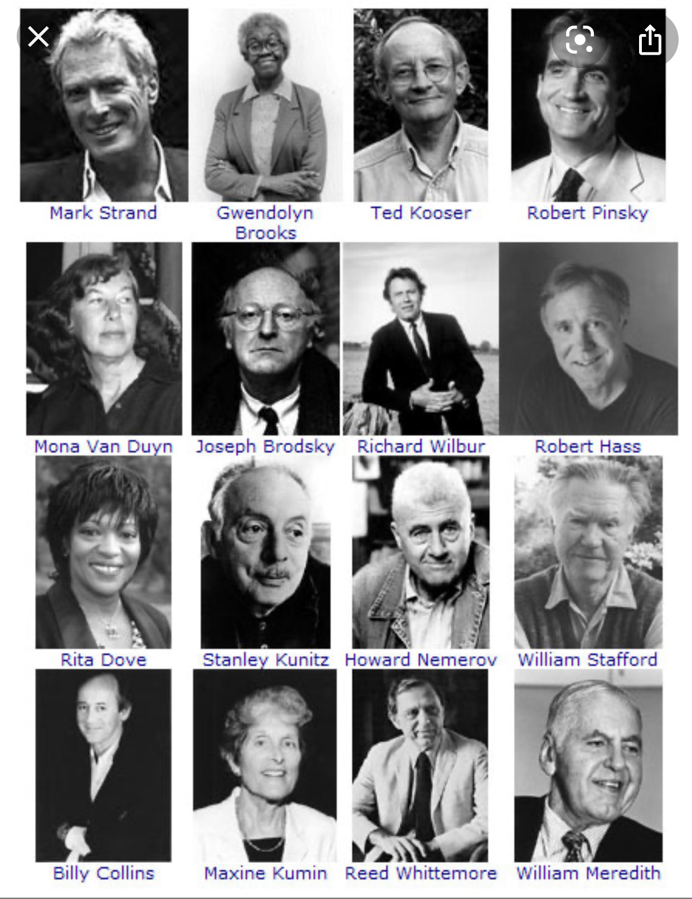
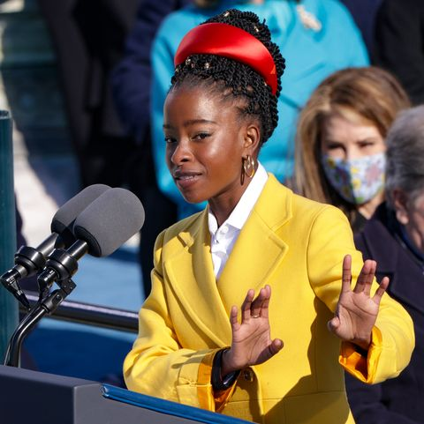
First National Youth Laureate
Four Decades of National Poet Laureates

Slide 19
The Hill We Climb
“In my poem, I’m not going to in any way gloss over what we’ve seen over the past few weeks and, dare I say, the past few years. But what I really aspire to do in the poem is to be able to use my words to envision a way in which our country can still come together and can still heal.” NY Times Interview, January 19, 2021 https://www.nytimes.com/2021/01/19/books/amanda-gorman-inauguration-hill-we-climb.html

Slide 20
Frame
of
Reference

Slide 21
Have you have traveled to:
Other cities
Other states
Other countries
Do you have a serious conversation(s) with people different than you?
Do you visit homes of people different than you?
Do you go out to eat with people different than you?
Do you have friends who are different than you in terms of race, ethnicity, religion and/or nationality?
How can you be intentional with doing the above?

Slide 22
Have you have traveled to:
Other cities
Other states
Other countries
Do you have personal conversations with people different than you?
Do you visit homes of people different than you?
Do you go out to eat with people different than you?
Do you have friends who are different than you in terms of race, ethnicity, religion and/or nationality?
How can you be intentional with doing the above?

Slide 23
Have you have traveled to:
Other cities
Other states
Other countries
Do you have personal conversations with people different than you?
Do you visit homes of people different than you?
Do you go out to eat with people different than you?
Do you have friends who are different than you in terms of race, ethnicity, religion and/or nationality?
How can you be intentional with doing the above?

Slide 24
Have you have traveled to:
Other cities
Other states
Other countries
Do you have personal conversations with people different than you?
Do you visit homes of people different than you?
Do you go out to eat with people different than you?
Do you have friends who are different than you in terms of race, ethnicity, religion and/or nationality?
How can you be intentional with doing the above?

Slide 25
Have you have traveled to:
Other cities
Other states
Other countries
Do you have personal conversations with people different than you?
Do you visit homes of people different than you?
Do you go out to eat with people different than you?
Do you have friends who are different than you in terms of race, ethnicity, religion and/or nationality?
How can you be intentional with doing the above?

Slide 26
?
?
?
?
?
More ways you can be intentional with having difficult conversations?

Slide 27
Collaboration
Develops
Relationships

Slide 28
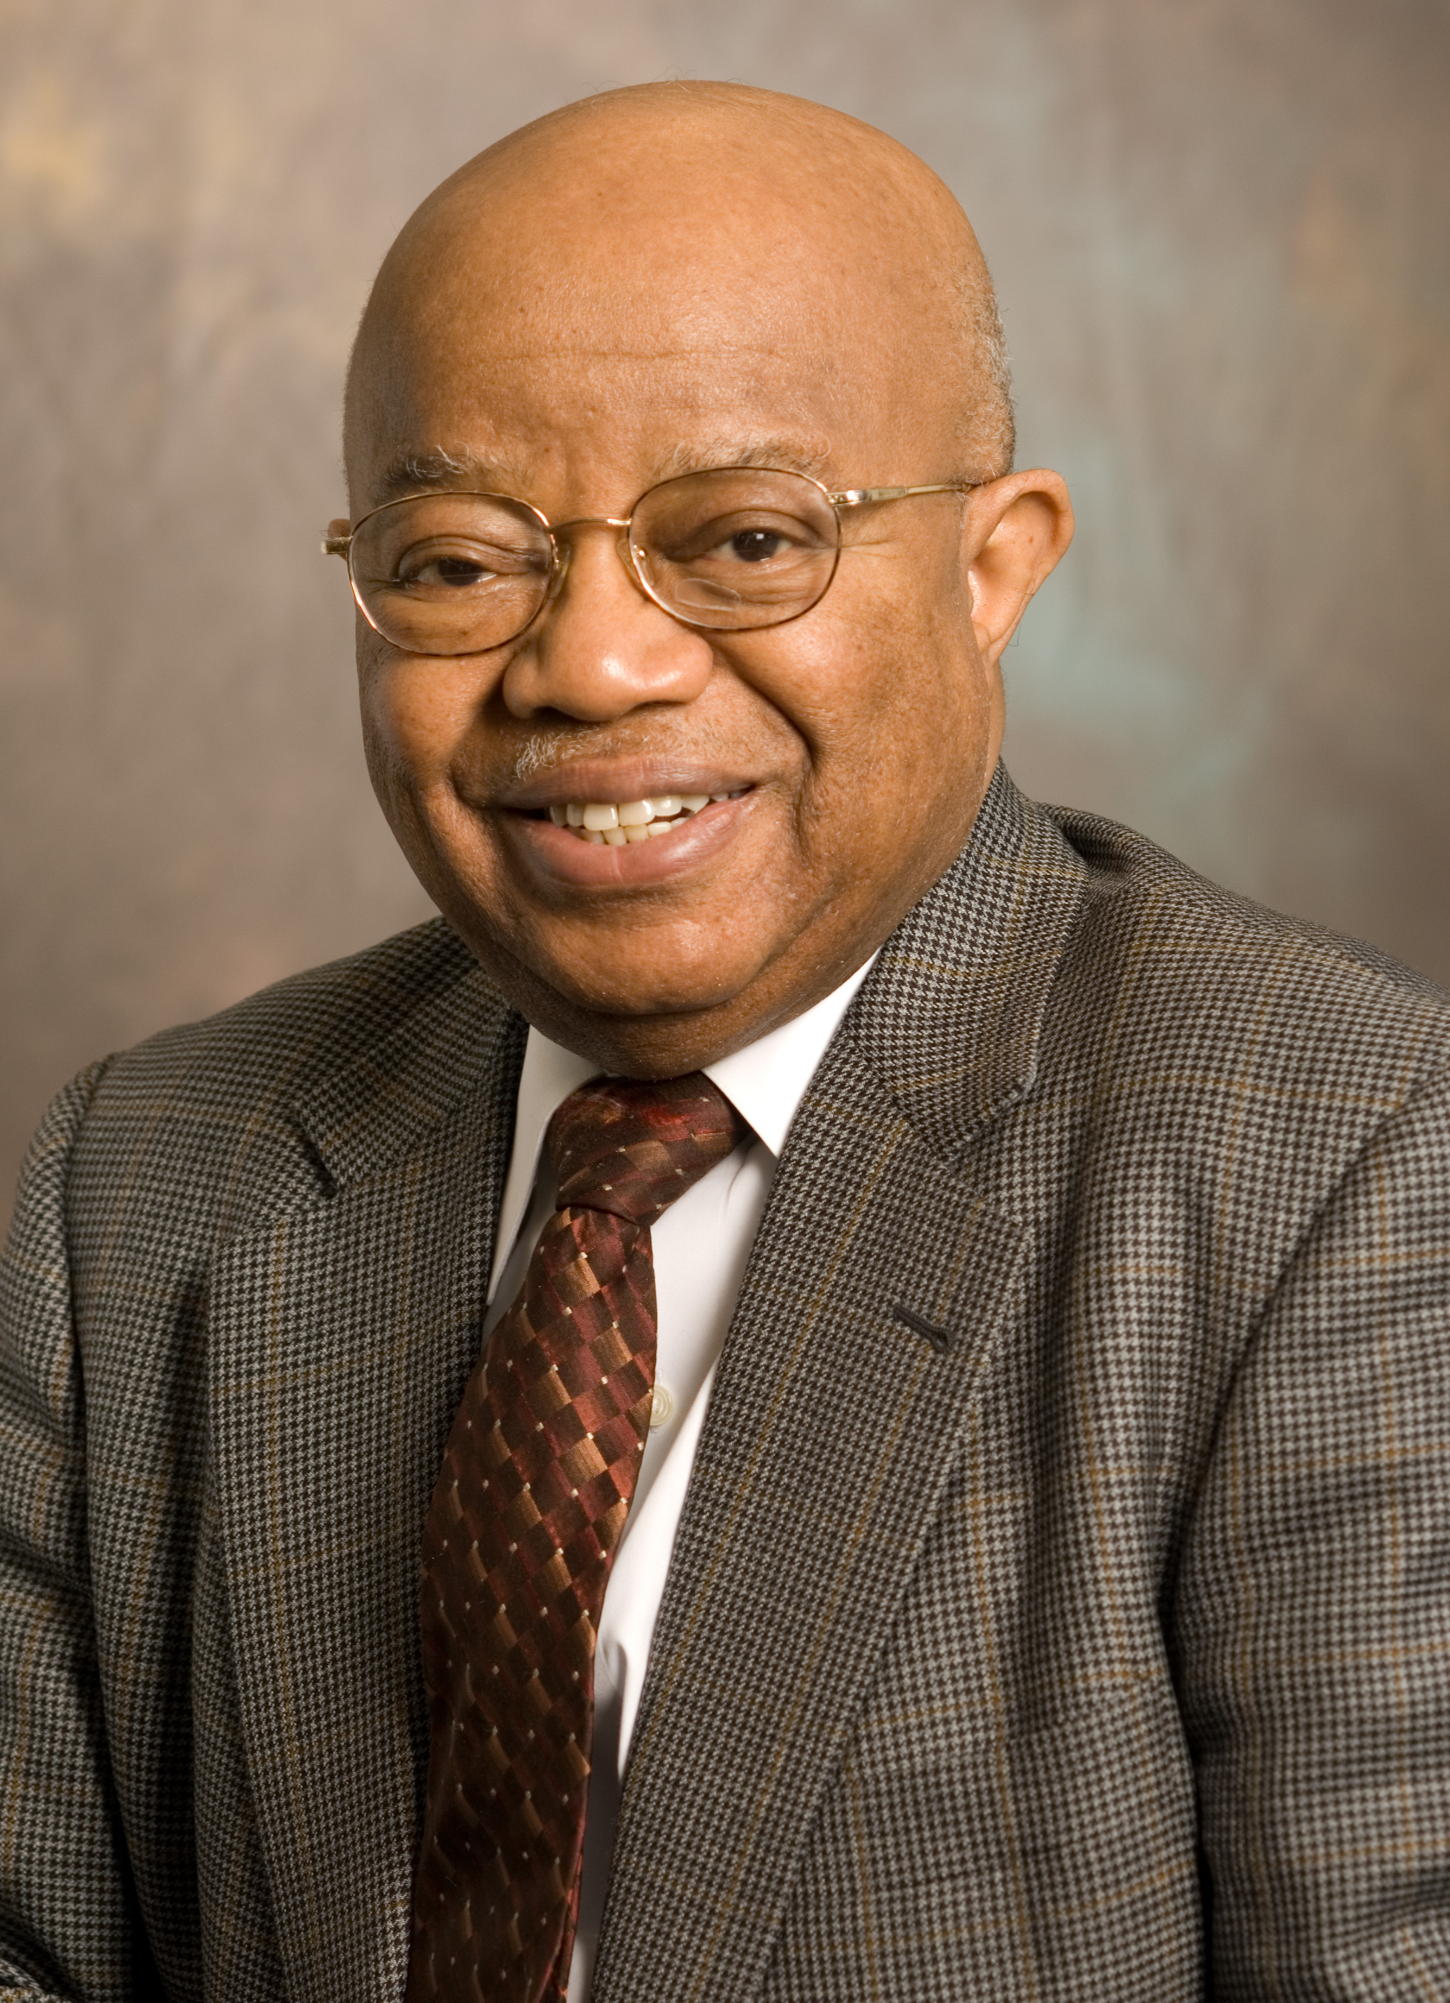
“There can be no significant learning without significant relationship.”
-Dr. James Comer

Slide 29
High Operational Practices
Strategies and Pedagogy
The Why—The How

Slide 31
Cultural Frame of Reference
Cultural Frame of Reference

Slide 32
Experiences, Schema
Cultural Frame of Reference
Cultural Frame of Reference

Slide 33
Experiences - Schema
Places
Events
People You Know
People Who Inspire
Books, Music, Movies
Travel
Values
Dispositions
Cultural Frame of Reference
Cultural Frame of Reference

Slide 34
Other Factors
and Experiences
That Affect Our
Cultural Frame
of Reference
Cultural Frame of Reference
Cultural Frame of Reference

Slide 35
Circle Map - Defining in Context - Frame
Experiences - Schema
Places
Events
People You Know
People Who Inspire
Books, Music, Movies
Travel
Values
Dispositions
Who we are as
cultural humans
ancestors
stories taught
We
languages
know history
to be better citizens
Notes:
All do a circle map.

Slide 36
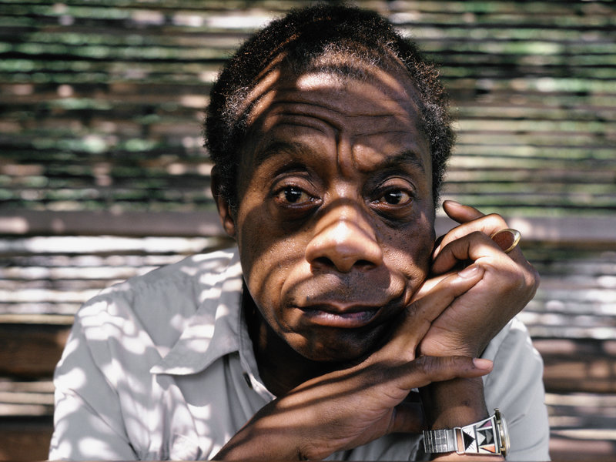
“In order for this to happen, your entire frame of reference will have to change, and you will be forced to surrender many things that you now scarcely know you have.” ― James Baldwin, The Fire Next Time

Slide 37
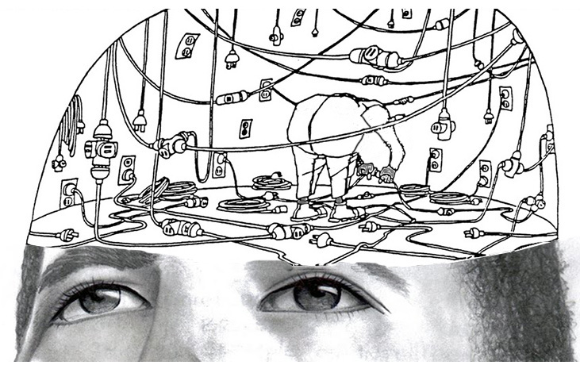
Frame of Reference
Schema
Notes:
FROM OUR SCHEMA
a particular attitude toward or way of regarding something; a point of view.
"most guidebook history is written from the editor's perspective"

Slide 38
Frame of Reference
Situating Learning
in the Lives of Students
Schema
Notes:
FROM OUR SCHEMA
a particular attitude toward or way of regarding something; a point of view.
"most guidebook history is written from the editor's perspective"

Slide 39
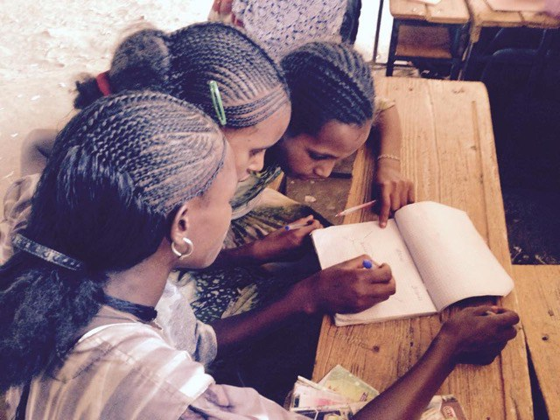
Schema
Text to Self
Text to Text
Text to World
Text to Self
Text to Text
Text to World
Schema is the background knowledge and experience readers bring to the text. Good readers draw on prior knowledge and experience to help them understand what they are reading and are thus able to use that knowledge to make connections.

Slide 40
Text-to-Self
What does this remind me of in my life?
What is this similar to in my life?
How is this different from my life?
Has something like this ever happened to me?
How does this relate to my life?
What were my feelings when I read this?
Text-to-World
What does this remind me of in the real world?
How is this text similar to things that happen in the real world?
How is this different from things that happen in the real world?
How did that part relate to the world around me?
Text-to-Text
What does this remind me of in another book I’ve read?
How is this text similar to other things I’ve read?
How is this different from other books I’ve read?
Have I read about something like this before?
Schema

Slide 41
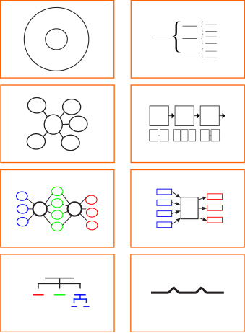
Schema
—text to text
—text to self
—text to world
Defining
In
Context
Whole
Part
Qualities
Sequencing
Comparing
and
Contrasting
Cause
And
Effect
Classifying
Relationships
Analogies

Slide 42
Note Details and/or Evidences
Identify The Rules
Observing Patterns Recognizing Trends
Identify Ethical Considerations
Questions for Inquiry
What is the Principle, Theory or Big Idea
Relationships Over Time
Multiple Frames of Reference (Perspectives)
Interdisciplinary Connections
Frame
of
Reference
Frame
of
Reference

Slide 43
Critical
Thinking

Slide 44
“Los estudiantes deben tener iniciativa; no deben ser meros imitadores. Deben aprender a pensar y actuar por sí mismos y ser libres ".
“Students must have initiative; they should not be mere imitators. They must learn to think and act for themselves, and be free.”
—Caesar Chavez

Slide 45
Belief &
Belonging

Slide 46
“There can be no significant learning without significant relationships.”
-Dr. James Comer

Slide 47
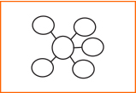
Bubble Map for Qualities Supporting Change
Use a Bubble Map to write or draw in the bubbles around the center bubble the qualities supporting change. In the Frame of Reference write or draw how does that come about?

Slide 48
Key
Vocabulary
Prediction
together
equity-driven
achieves
self-transcendence
choices
frontier
innate
available
designed
invitation­­­
Pedagogy of Confidence

Slide 49
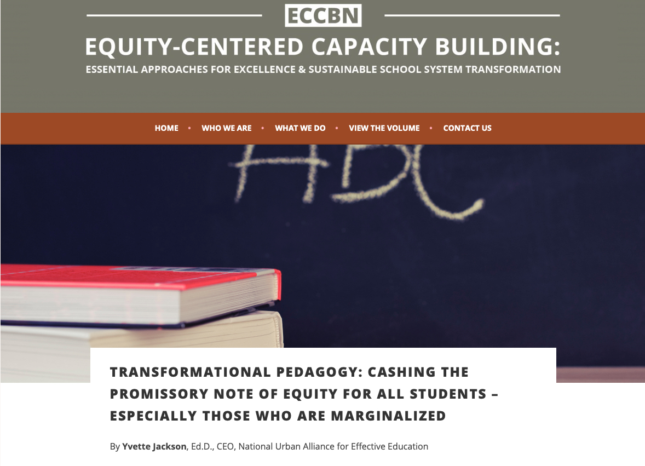
Excerpt from The Pedagogy of Confidence Article Transformational Pedagogy: Cashing The Promissory Note of Equity For All Students – Especially Those Who Are Marginalized, Capacity Building Network Online
Pedagogy and equity must work together. When we are truly committed to equity, we design pedagogy that achieves its original purpose: “to lead a child” for self-actualization and self-transcendence; self-actualization that enables students to thrive in society, and self-transcendence that motivates them to contribute to that society (Chen, 2014; Freire, 2012; Gladwell, 2008; Jackson, 2011).

Slide 50
Excerpt from The Pedagogy of Confidence:
One ideology that offers a concrete vision of what equity-driven pedagogy should be is “gifted education.” (As used here, gifted education is distinguished from programs for students “labeled as gifted.”) In this ideology, students are “gifted” with pedagogy in which: a) belief in and expectations for their ability drive the direction, instructional choices and opportunities that are made available to them; b) their education is actually designed as an invitation for them to explore the “frontier of their intelligence; their innate capital”; c) the practices, strategies and opportunities are designed to identify and cultivate their unique strengths, gifts and talents; and d) the invitations they receive through their education are complemented by guidance on how to apply the discoveries they make about their intelligence so they can better determine what they want to pursue to feel self-actualized and to experience agency and investment in society (Jackson, 2011, p. 86; Whyte, 2002).

Slide 51
Read – Discourse - Map
Pairs or Small Groups

Slide 52
Excerpt from The Pedagogy of Confidence:
Equity-driven pedagogy that generates practices and structures reflective of “gifted” education and the pursuit of excellence is what our organization describes as the Pedagogy of Confidence®. The Pedagogy of Confidence is based on the fearless expectation that all students are capable of high intellectual performances when provided High Operational Practices™ that motivate self-directed learning and self-actualization. High Operational Practices are actually labels for the categories of supports fundamental for eliciting high levels of engagement and intellectual processing. The practices can serve to guide teachers in choosing effective pedagogical strategies to optimize learning.

